Slide 1
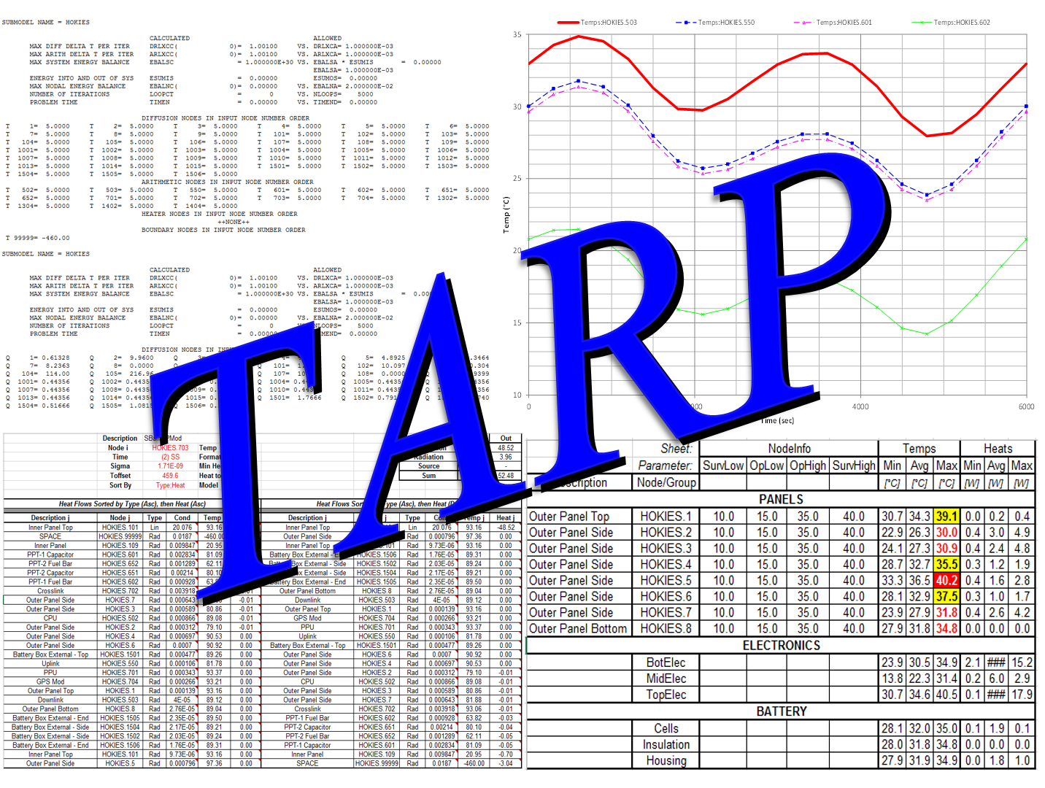

Slide 2
TARP® – Introduction
Commercial Thermal solvers provide temperature output for models based on heat and conductor inputs
The post-processing of results is generally left to the user. However, common methods for displaying output results can be identified.
TARP® generates objects to display data in a variety of ways: DataSets, Groups, Parameters, Plots, StripCharts, Tables, Graphical Tables, Radk Manipulations, Radk Compares, Backloads/Equivalent Sinks, HeatMaps, Static HeatMaps, Binary HeatMap Files, DerivedDataSets, MinMaxDataSets, and UserDataSets within the Microsoft Excel® environment. All the requested data is then available in Excel® for further processing if needed.

Slide 3
TARP® – Objects
TARP takes an object-oriented approach to
post-processing, allowing the user to create and define specified object types and Workbook Properties within the TARP environment. These object types include:
  DataSets: Sheets containing raw Data from output files
  Groups: Additional data point(s) representing multiple raw data points
  Parameters: Additional data point(s) representing a formula evaluation applied to multiple raw data points
  Plots: 2D representation of Data versus Time
  StripCharts: stacked versions of multiple plots
  Tables: 1D representation of Data at static points in Time
  GraphicalTables: Horizontal Bar charts showing limits and Max/Min predicts as error bar within range
  RadkManipulations: Post processing of Radks based on query-like approach (do some action(s) on some set(s) of radks)
  RadkCompares: Allows for comparison of two Radk sets based on Node Pair couplings. User specifies tolerance for allowable differences to exclude

Slide 4
TARP® – Objects
  Backloads/EqSinks: simplistic representation of radiative environment for subset of surfaces based on views to, and temperatures of, other surfaces. Equivalent sinks provide the same information in terms of a Temperature and a Radk instead of just a Heatload
  HeatMaps: Interactive workbook to show heat flow between Nodes or Groups
  Binary HeatMaps: creates external binary file containing data used by a HeatMap workbook. Much faster data retrieval for very large models (> 200K Conductors)
  Static HeatMap: worksheet displaying heat flows for specified node/group
  DerivedDataSet: DataSet with values calculated from raw data (e.g. dT/dt)
  MinMaxDataSets: Sheets containing Min and Max temps from multiple output files with each column representing one file
  UserDataSet: DataSet with user specified points and a variety of data options including: HeatFlows, Env Heat, Max Temp, Backloads, Sinks, etc
  Once defined, an Excel® workbook is created containing the objects requested and defined by the user

Slide 5

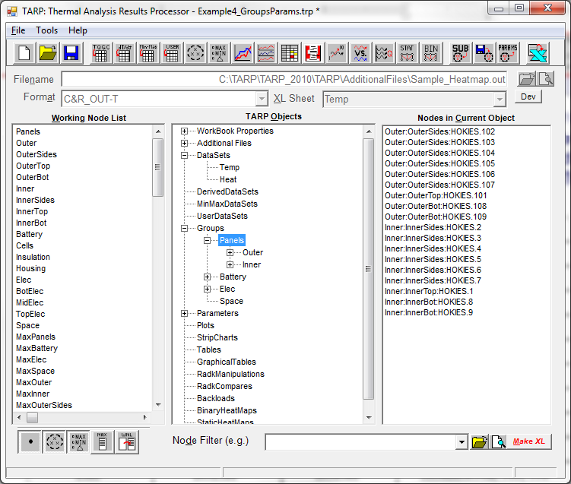
















TARP® – Main Interface
Interface
DataSet
Plot
Group
StripChart
Parameter
Table
Replace
DerivedDataSet
GraphicalTable
MinMaxDataSet
RadkManipulation
UserDataSet
RadkCompare
Backload/Sink
HeatMaps
StaticHeatMap
BinaryHeatMap

Slide 6
TARP® – Main Interface
Options set by user to define additional file references and properties of the output workbook
Objects created by user
  DataSets
  DerivedDataSets
  MinMaxDataSets
  UserDataSets
  Groups
  Parameters
  Plots
  StripCharts
  Tables
  GraphicalTables
  RadkManipulations
  RadkCompares
  Backloads/EqSinks
  Binary HeatMaps
  Static HeatMaps
Node Filter accepts ranges (1-100) and/or individual nodes (SUB.1)
Data added to Objects via the “Working Node List”
Nodes displayed for current object

Slide 7
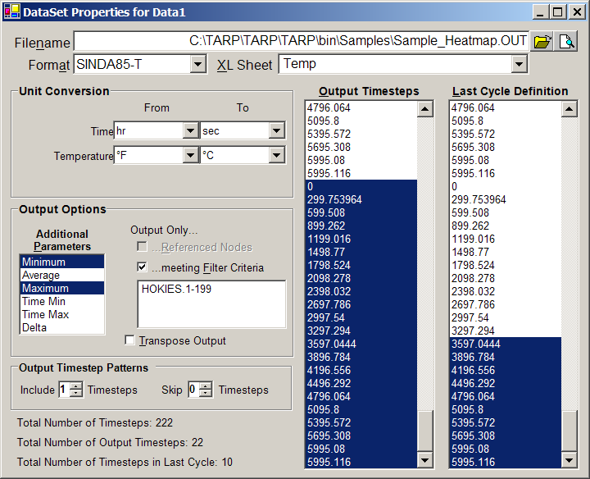
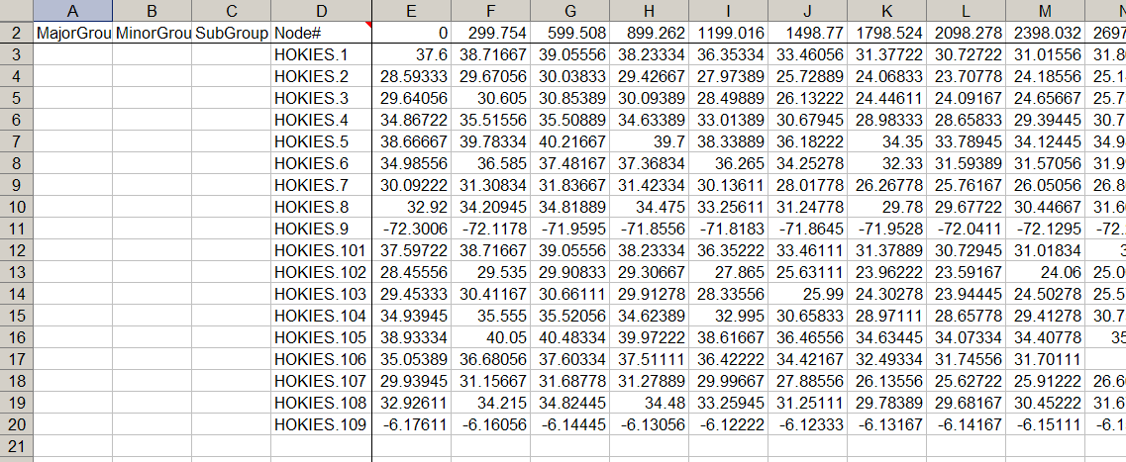
TARP® – DataSets
TARP Input
Select File, Format, and Data Sheet Name
Convert Units
  Time, Temperature, Heat, Area, Conductance, Capacitance
Control Node Output
  All Nodes, Range of Nodes, Referenced Nodes, Transpose
Control Timestep Output
Define Last Cycle
  Min, Avg, Max, etc
  Definition of Last Orbit
Output

Slide 8
TARP® – DataSet Formats
Many formats and parameters are supported in TARP including:
Format | Parameters
SINDA/FLUINT (.out, .sav, .csr) | T, Q, G, C
FLUINT | LT, LP, LX, LV, LD, LH, LQ, LM
SINDA/G | T, Q, G, C, F
ESATAN (PRNDBL) | T, Q, QS, QA, QE, QI, QR, G, GL, GR, C
ESATAN (PRNDTB) | T, Q, QS, QA, QE, QI, QR
TMG | T, Q (QNODEF)
TAK2000 | T, Q, G, C
TSS | Q, QS, QA, QE, Q”, QS”, QA”, QE”
ThermalDesktop (.hr*) | Q, QS, QA, QE, Q”, QS”, QA”, QE”
COVeR | T, Q, G, C
Comma, Space or Tab Delimited | N/A

Slide 9
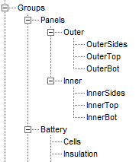
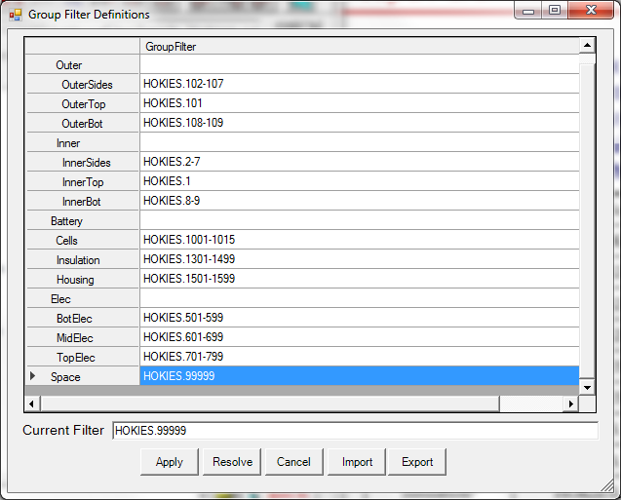
TARP® – Groups
Groups are the average temperature or total heat load of all nodes contained in the group
A Weighting File exists to better represent group temperatures
Groups may be:
  Created Manually
  Generated based on Submodels
  Loaded from an External File
  Made a Child of selected group
  Made a Sibling of selected group
Nodes may be:
  Defined in only one group (but may be included in multiple groups based on hierarchy [up to 5 levels])
  Explicitly Added (drag and drop)
  Implicitly added by defining ranges
    Ranges are evaluated to determine which nodes exist in the group

Slide 10
TARP® – Parameters and Session Files
Parameters, like groups, create additional data points that may be plotted or tabulated
5 types of Parameters may be defined: Max/Min of nodes, and Max/Min of a Group, and Difference
  Difference parameters may be between nodes, groups, and or parameters or any combination of these (e.g. MaxGroup – MinGroup)
MaxGroup and MinGroup parameters may be automatically created for all defined groups
Session files allow a user to save all definitions of all TARP objects and Workbook properties to an ASCII text file for later retrieval and modification
The Session File follows a simple to understand format:
<Object>
… Properties…
End <Object>
The format for each object is described in the User’s Manual

Slide 11
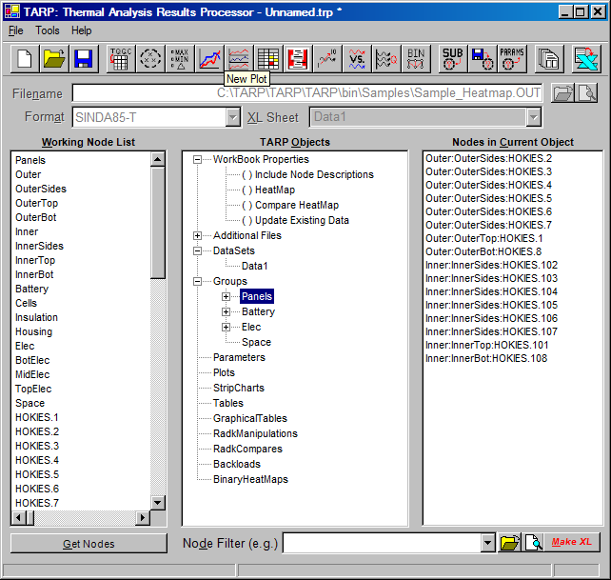

TARP® –Groups/Parameters
Groups may be alternately defined using ranges. This form is
Accessed by double clicking any group.
  Ranges of nodes may be entered and then evaluated to determine which nodes meet the criteria
Some shortcuts for working with groups are found on the tool bar
  Create Groups from Submodels
  Load Groups from Files
Parameters, like groups, create additional points for later use
  A shortcut to create MaxGroup and MinGroup parameters for all defined groups is also found on the toolbar
When parameters are defined, the type of parameter must be specified
EXAMPLES
Create a single Max of Group parameter
  Add the Panels entry from the Working Node List to Parameter1
Now, click the Create Max/Min Parameters from Groups button
  Select Yes when prompted to remove all existing Parameters first

Slide 12
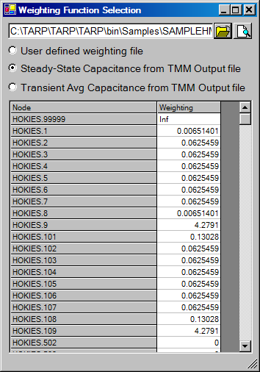
TARP® – Groups/Parameters (cont’d)
Groups are by default the unweighted average of all temperatures
or the sum for all heat loads
A Weighting File option exists to better represent the group temperature average
Options exist for:
  User specified weighting
  Capacitances based on Steady State Temps
  Capacitances based on Transient Average Temps
Once loaded, the Capacitances are saved to a temporary file for faster loading
A Weighting File option exists to better represent the group temperature average
This can be very useful for including arithmetic or MLI nodes, but excluding them from the calculation of the group average temperature
EXAMPLES
Select WeightingFile from the Additional Files branch of the Object Tree
Select Steady State Capacitance from TMM Output File, followed by the .out file
Close the form and save the file as CapacitanceWeighting.csv

Slide 13


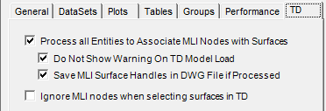
TARP® – Group Selection in Thermal Desktop
Groups can now be defined by selecting entities directly from within Thermal Desktop®
To begin, a link must first be established by selecting the Link to Thermal Desktop button and selecting the dwg file
To interact with TD, TARP must establish relationships between TD object handles and their related nodes
  It should be noted that TD objects do not explicitly include MLI nodes. Therefore, to allow selection of MLI nodes, surfaces must be evaluated to determine MLI nodes.
There are two modes in which TARP allows interaction with TD:
  The first, processes all nodal related objects (e.g. FE, FDSolids, etc) and keeps track of the MLI nodes found when processing all entities
    This mode may take considerable time to process all entities in a model
    A known issue exists for very large models where the method fails when retrieving all entities of a specified type. In this case, TARP will automatically fall through to using the DBIterator object, which is slower but does not suffer from this limitation
    Options also exist to save and restore these NodeID:Handle associations within the DWG for faster subsequent processing
  The second only includes MLI associations for
  nodes added to groups within that TARP session
If no MLI nodes need to be displayed,
then Method 2 is preferrable

Slide 14
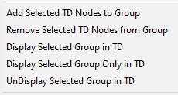
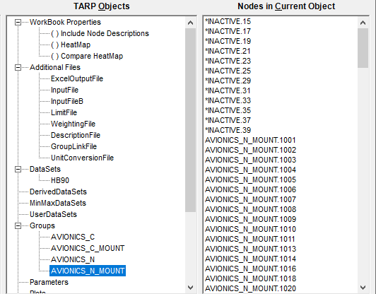
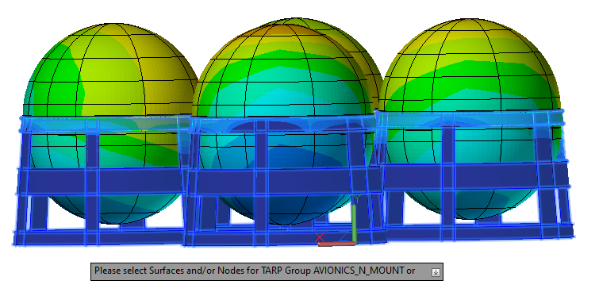
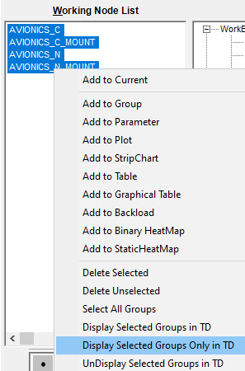
TARP® – Group Selection in Thermal Desktop
Once a Group has been defined in TARP, the context menu gives options for working with TD
Nodes may be added to or removed from a group by
selecting them graphically in TD
Individual Groups may also be Displayed, UnDisplayed, or Only Displayed
The Working Node List has options to allow this for multiple group selections

Slide 15
TARP® – Examples
Example 1: DataSets, Groups, Parameters, TD
Example 2: Table, Graphical Table, Plot, StripChart
Example 3: Radk Manipulation, Radk Compare, BL/Sinks
Example 4: HeatMaps
Example 5: Advanced DataSets

Slide 16

TARP® – Example 1: DataSets, Groups, Parameters
At the Main Interface, select Data1 and click a second time to edit the name. Change from Data1 to HB90.
Click the OpenFolder button to the right of Filename and select the Hot_b90.out file. Notice the nodes in the file have now been added to the Working Node List. If no nodes are being displayed, it is possible that the toggle to display Nodes in the Nodes, Group and Parameters toolbar has disabled it.
At the Main Interface, right click in the Object Tree and select Add Multiple
Add a new DataSet and a form will appear requesting the names for each new object to add. Add HB60, HB30, HB00, CB90, CB60, CB30, and CB00 and then select the appropriate files for each as in step 2.
Double click on HB90 in the TARP Objects tree to bring up the properties and select Timesteps 14100 through 22248.9 in the Last Cycle Definition. This will be the range over which data is evaluated for the Min, Max, Avg, etc. or would be plotted.
Convert the Time from Sec to Hr and perform the same steps for all other DataSets
Select the HB90 DataSet and click the Make Groups from Submodels button
This will prompt for an MLI offset. If a model has been defined such that all insulation nodes are above a specified value (e.g. 100000), this makes for easy identification of MLI nodes simply by node number. In this case, if a submodel has both MLI and non MLI nodes, then SubName_Str and SubName_Ins groups are created under the SubName group. In many cases, submodels make be sufficient to define groups, but if not, users do have full control over which nodes are assigned to which groups. Specify 100000 at the prompt.

Slide 17
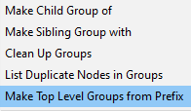
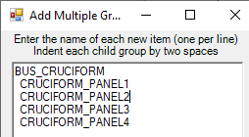

TARP® – Example 1: DataSets, Groups, Parameters
Furthermore, models that utilize prefixes to organize related
Submodels using an underscore, TARP can further define the
hierarchy. Select the Make Top Level Groups from Prefix option
under the right click context menu to create top level AVIONICS,
INST, and BUS groups
In this case, it also created a SOLAR_ group, which is not really
desired. Select the SOLAR_PANELS group and drag it to Groups. This will now make it a child group of the selected group, allowing the user to reorganize the hierarchy using drag and drop operations.
This now orphans the SOLAR_ group, which can be selected and removed by pressing the Delete key
IF NOT A Thermal Desktop USER, SKIP AHEAD TO STEP 20...
Delete the BUS_CRUCIFORM group and select BUS_ to add
BUS_CRUCIFORM and 4 child groups: CRUCIFORM_PANEL1, 2,
3, and 4, by indenting 2 spaces for each level. This is often an
easier method for defining group hierarchies than adding groups
manually
Click the Link to TD button and select the Sample_SC.dwg file.
Display only the BUS_CRUCIFORM submodel and turn on node
numbers (without tracing children) for 1020, 2020, 3020, and 4020.
After selecting CRUCIFORM_PANEL1 in TARP Objects, right click
to bring up the context menu and select Add Selected TD Nodes to
Group.

Slide 18
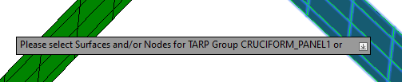
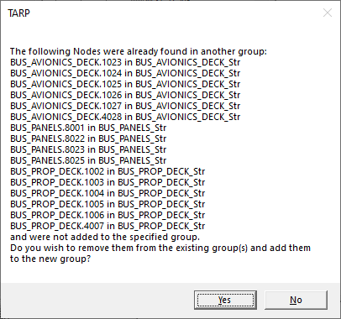
TARP® – Example 1: DataSets, Groups, Parameters
A prompt is now displayed in TD requesting surface
selection. Select the surface associated with node 1020
and compete the selection by hitting return
TARP has identified a number of nodes associated with
that surface that were already found in other groups.
In this case, select no to leave the nodes in their current
Group. Repeat for CRUCIFORM_PANEL2-4.
Remove nodes 4014 and 4021 from CRUCIFORM_PANEL1
by selecting them in the Node in Current Object listbox
and hitting delete. Select Not in Group in the Node Filter
to show those nodes in the Working Node List. Select
them, then Drag and Drop onto the CRUCIFORM_PANEL4
group in the TARP Objects tree to add them.
Skip to step 21…
Select the BUS_CRUCIFORM group, then select nodes
in the 1xxx range in the Nodes in Current Object listbox,
right click to bring up the context menu and select Demote to ChildGroup → New ChildGroup… Rename the new group CRUCIFORM_PANEL1. Repeat for ranges 2, 3,
and 4xxx and CRUCIFORM_PANEL2, 3, and 4
Select the Groups to Parameters button to create MinGroup and MaxGroup parameters for each defined group. This will compute the hottest node and coldest node for each group.
Select ExcelOutputFile in the TARP Objects tree, click the File Open button beside the Filename text box and given the workbook a name of your choosing. Save this session as TARP_Example1.trp using the save button on the main Toolbar

Slide 19
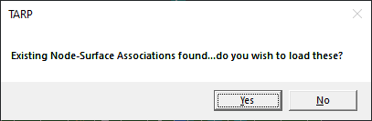
TARP® – Example 1: DataSets, Groups, Parameters
Having saved the session, close TARP and open a new instance. Load the session by selecting the Open Session button on the main toolbar and select TARP_Example1.trp, but do not execute it yet. Note that all the defined DataSets, Groups, Parameters are still included
If not using Thermal Desktop, skip to step 27…otherwise, close Sample_SC.dwg
Click the Link to TD on the main toolbar and
select Sample_SC.dwg. It should prompt if you
wish to load existing Node-Surface associations.
Select yes. For very large models, this can result
In considerable time savings if all the entities had
Already been processed and stored. Note that the button is now Cyan indicating that all the surfaces are processed and ready for use.
Select the INST_ group in the TARP Objects tree, right click to bring up the context menu and select Display Selected Group Only in TD. Note the impact in the Thermal Desktop session. Now select INST_BRACKETS and UnDisplay Selected group in TD. Multiple groups can also be selected in the Working Node List and the Display, Display Only, and UnDisplay actions performed. Note that all this is achieved without having to define groups from Thermal Desktop
Note that as groups are selected in the TARP Objects tree, the nodes contained therein are displayed in the Nodes In Current Object listbox. An option exists to display the hierarchy as well (Tools-Preferences-Groups Tab-Show Nodes in Child group…)
Lastly, click the Make XL button to generate the Microsoft Excel workbook

Slide 20
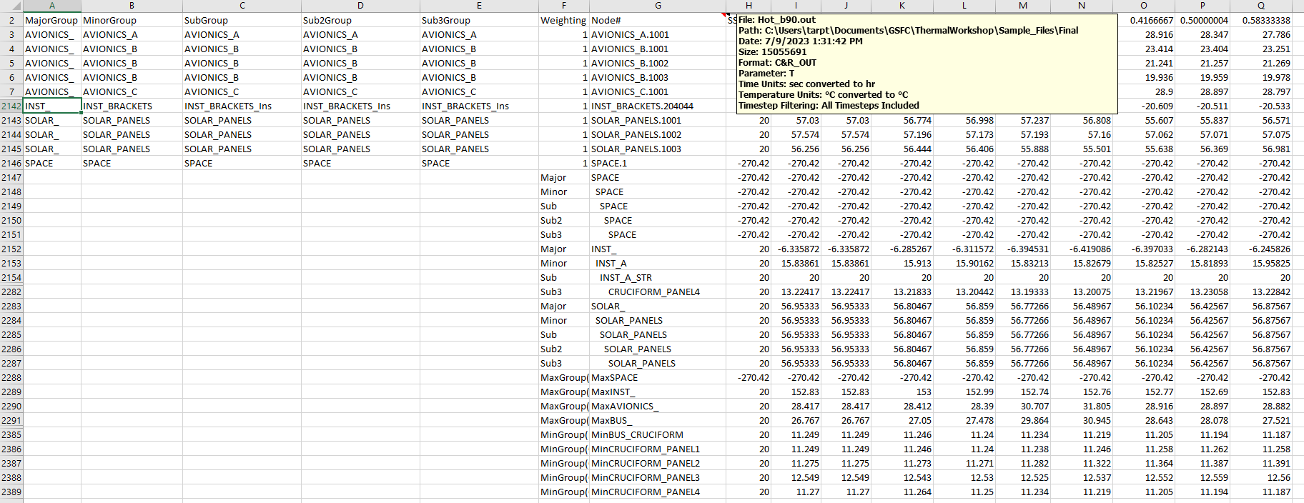
TARP® – Example 1: DataSets, Groups, Parameters
Note the layout of the DataSet: Col A-E are group assignments,
Col F is a weighting factor, Col G is the Node/Group/Parameter, and Cols H-CG are the timesteps. Cols CH-CL are the Min,Avg,Max,TimeMin, and TimeMax over the last cycle
Cell G1 includes a Comment with information about the data: File name, path, size, etc
After the Nodal data is the block of the computed Group data. This may include groups propagated to lower levels as well (e.g. SubGroup to Sub2 and Sub3Group). Column F defines the group level
After the Group data is the block of the computed Parameter Data. Column F defines the Parameter type and inputs
Group Data
ParamData

Slide 21
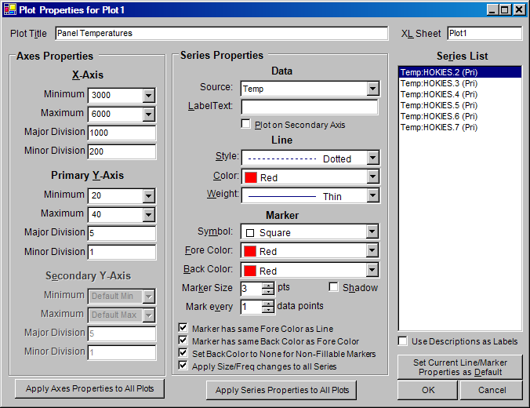
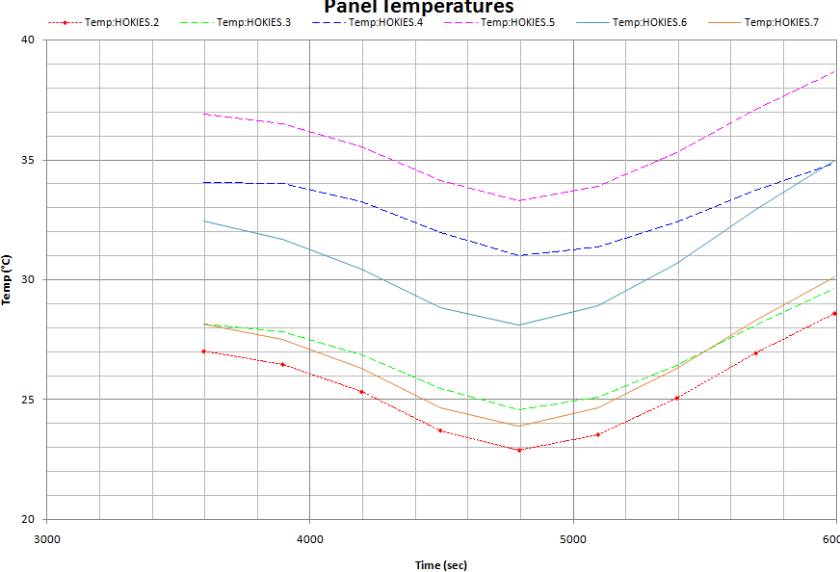
TARP® – Plots
TARP Input
Control X-Axis, Y-Axis, and Secondary Y-Axis properties
  Minimum, Maximum, Major and Minor Division
Control Series Data
  Source Sheet, Label, Axis
Control Line Properties
  LineType, Color, Weight
Control Marker Properties
  ForeColor, BackColor, MarkerType, Size, Shadow, Frequency
Apply formats to all Plots
Output

Slide 22
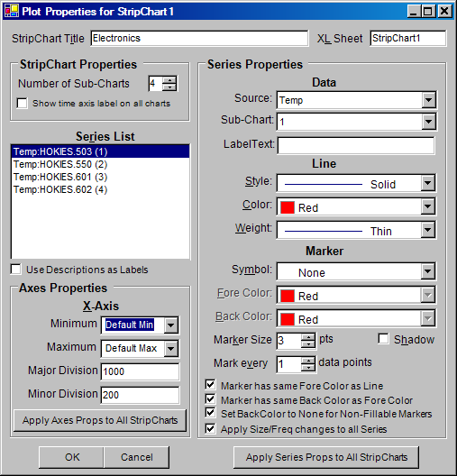
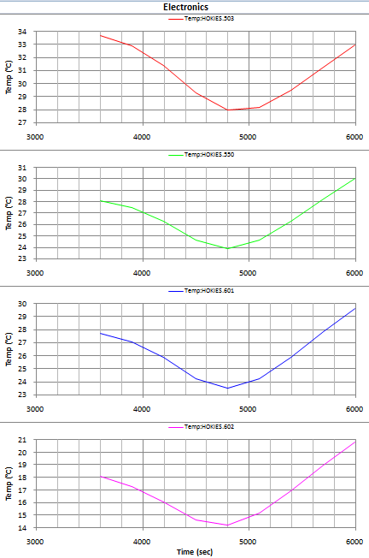
TARP® – StripCharts
TARP Input
Output
Number of Sub-Charts to display
X-Axis properties
  Minimum, Maximum, Major and Minor Division
Source Datasheet , Sub-Chart , Label
Line Properties
  LineType, Color, Weight
Marker Properties
  ForeColor, BackColor, MarkerType, Size, Shadow, Frequency
Apply formats to all StripCharts

Slide 23
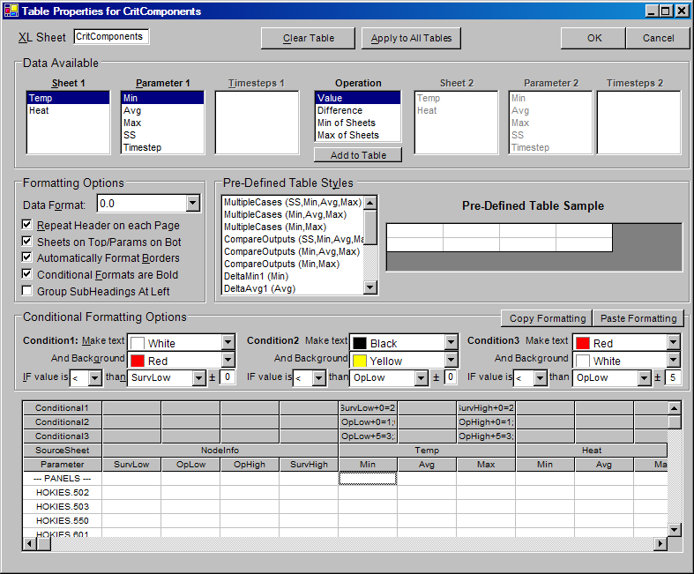
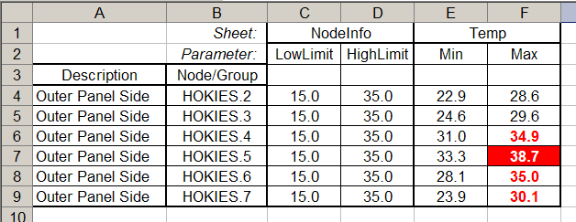
TARP® – Tables
TARP Input
Select Column Type
  Simple value, Difference, Max/Min of Sheets
Select Source Sheet(s)
Select Tabular Data
  Minimum, Maximum, Average, Steady-State, Timestep, Limit
Conditional Formatting to Highlight Out-of-Limit Conditions
Formatting options for Table display
Predefined tables for quick creation
Apply formats to all Tables
Output

Slide 24
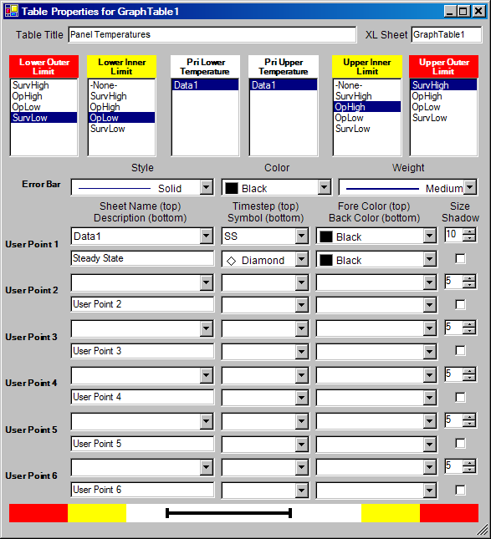
TARP® – GraphicalTables
GraphicalTables are a means to graphically show nodal predictions and where they fall within specified limits
User specifies one or two sets of limits (e.g. Warning / Failure)
Maximum / Minimum Predicts shown as Error bar within range
Error bar control
  Color, Weight, Line Type
Up to 6 User Points
  Sheet/Timestep
  Symbol, Color, Size, Shadow
  Description
TARP Input

Slide 25
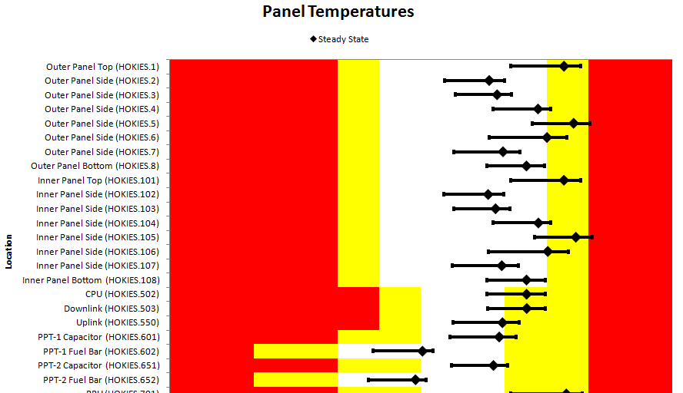
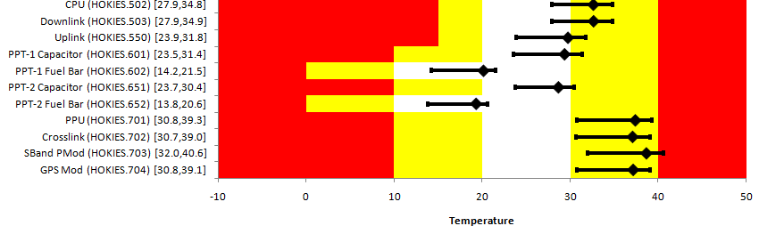
TARP® – GraphicalTables
Output
Toggle within Excel to display values
Output

Slide 26
TARP® – Examples
Example 1: DataSets, Groups, Parameters, TD
Example 2: Table, Graphical Table, Plot, StripChart
Example 3: Radk Manipulation, Radk Compare, BL/Sinks
Example 4: HeatMaps
Example 5: Advanced DataSets

Slide 27
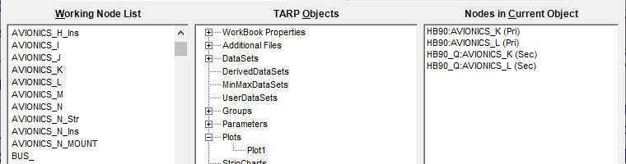
TARP® – Ex. 2, Plot, StripChart, Table, Graphical Table
Open the session file for Example 1 to load all the DataSets,
Groups, and Parameters
Create a new dataset named HB90_Q, specifying C&R_OUT-Q, the Hot_B90.out file, convert time from s to hr, and select the Last Cycle from 4 to 6.18
Select groups Avionics_K and Avionics_L in the Working Node List, right click to bring up the context menu and select Add to Plot - New Plot… Note that Plot1 has been created and there are two entries in the Nodes in Current Object listbox. For a Plot, this follows the syntax: DataSetName:Node/Group/Parameter (Pri|Sec) for the source dataset, data to plot, and axis.
Select the two series, right click and select Change Source-HB90
Again select the two series in the Working Node List and add to Plot1 by dragging and dropping onto the Plot1 in the TARP Objects tree or into the Nodes In Current Object listbox. Select the two series for HB90_Q, right click and select Change Axis, which will assign these series to the secondary axis.

Slide 28
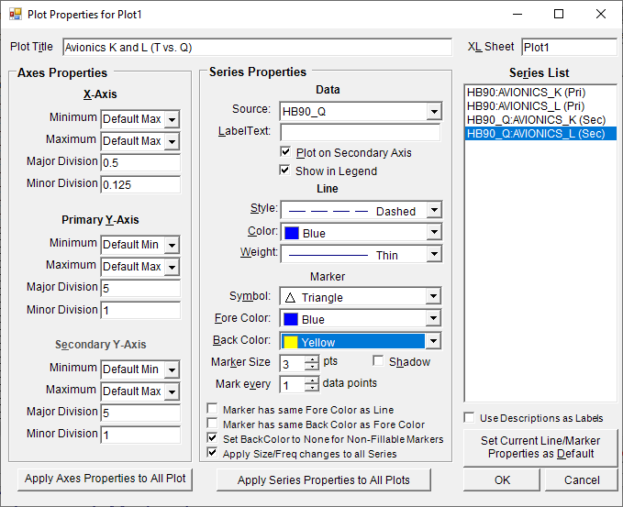
TARP® – Ex. 2, Plot, StripChart, Table, Graphical Table
Double click the Plot1 object in the TARP Objects tree
Specify 0.5 for the X-Axis Major Division and 0.0125 for the X-Axis Minor Division. Also specify the Plot Title as “Avionics K and L (T vs. Q)”
Select HB90:AVIONICS_K (Pri) in the Series List, and change the Line Color to Red, keeping the Line Style as Solid.
Change HB90:AVIONICS_L (Pri) to a Blue, Solid Line
Change HB90_Q:AVIONICS_K (Sec) to a Red, Dashed Line
Change HB90_Q:AVIONICS_L (Sec) to a Blue, Dashed Line
For HB90_Q:AVIONICS_K (Sec):
  Set the Symbol to a Square
  Note that the Fore Color and Back Color are also red. This behavior is governed by the check boxes below the Marker definition
  Uncheck Marker has same Fore Color as Line and Marker has same Back Color as Fore Color
  Set the Back Color to Yellow
For HB90_Q:AVIONICS_L (Sec):
  Set the Symbol to a Triangle
  Set the Back Color to None. This will make for an unfilled marker

Slide 29
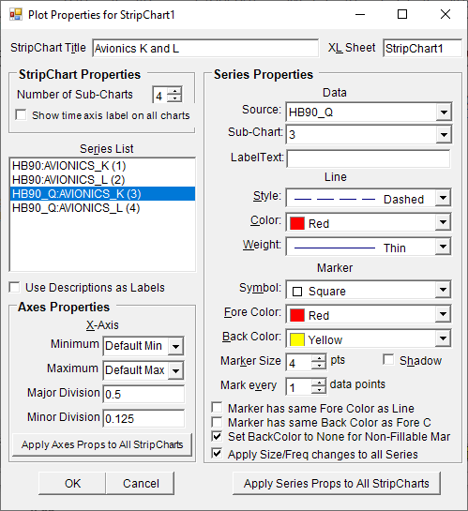
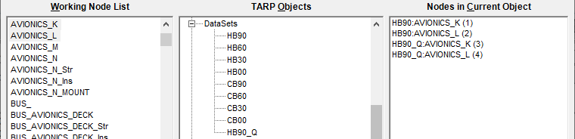
TARP® – Ex. 2, Plot, StripChart, Table, Graphical Table
Select the HB90 Dataset. Then select AVIONICS_K and _L in
the Working Node List. Right click and select Add to StripChart – New StripChart…
Now, select the HB90_Q DataSet and again select AVIONICS_K and _L, right click and select Add to StripChart – StripChart1
Note that similar to a Plot, each series includes additional information and follows a syntax of: DataSetName:Node/Group/Param (SubChart Number [1-6]). Similar to plots, a right click context menu in the Nodes in Current Object allows respecification of the Source DataSet and SubChart number
Double click StripChart1 in the TARP Objects tree to access the properties
Set the title to “Avionics K and L”. Set the Major Division to 0.5 and the Minor division to 0.125.
Set the series properties per the table below:
Series | Style | Color | Marker | Fore Color | BackColor
1 | Solid | Red | None | N/A | N/A
2 | Solid | Blue | None | N/A | N/A
3 | Dashed | Red | Square | Red | Yellow
4 | Dashed | Blue | Triangle | Blue | None

Slide 30
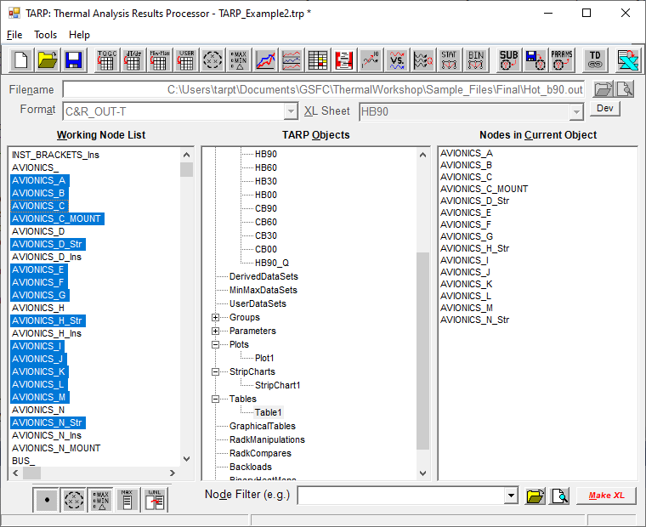
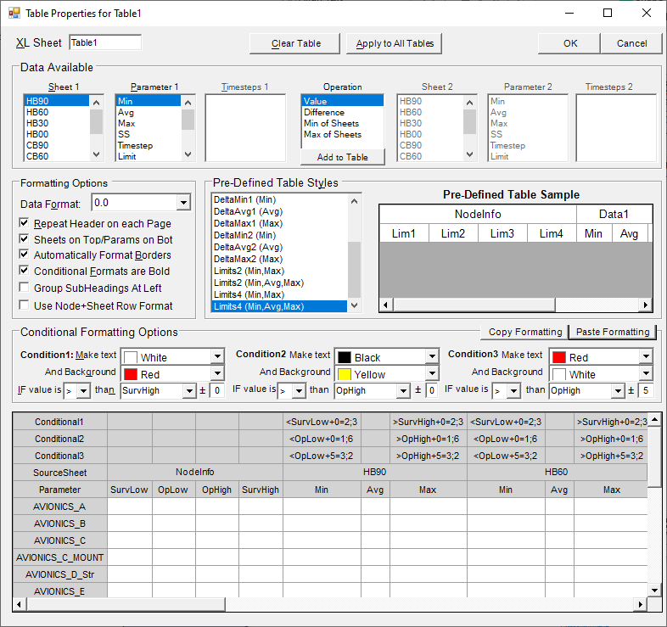
TARP® – Ex. 2, Plot, StripChart, Table, Graphical Table
Select the HB90 Dataset. Then select all the AVIONICS groups
shown below from the Working Node List. Right click and select Add to Table – New Table… There is no need to select the Insulation groups or its Parent.
Now, double click the LimitFile under AdditionalFiles in the TARP Objects tree and select the Sample_SC.lim file. This will allow for the addition of limits and limit checking to be available in Tables
Double click Table1 in the TARP Objects tree to bring up the Table Properties form

Slide 31
TARP® – Ex. 2, Plot, StripChart, Table, Graphical Table
Individual columns may be added to a Table by selecting the
source sheet and what parameter should be included (e.g. Min, Avg, Max, Limit, etc). The Operation listbox allows for additional values to be computed for a column, including a Difference or the Max or Min of a selection of DataSets.
Some of the entries in the Parameter listbox require additional data, such as Timestep or Limit. Once all of the necessary inputs are specified, clicking the Add to Table button will create that column in the table.
Including any Limit in a Table will add 3 additional rows for Conditional formatting, which allows for limit checking to be applied to a column. Condition 1 is checked first is if it is met, then the format is applied; if not, then condition 2 is checked next and so on. This is generally intended to be used to check if a survival limit is exceeded, then an operational limit, and lastly is insufficient margin exists to the operational limit utilizing the ± field.
For larger Tables, some Pre-Defined Table Styles exist. Select Limits4 (Min, Avg, Max) and double click it to create a table with the SurvLow, OpLow, OpHigh, and SurvHigh limits as well as Min, Avg, and Max columns for each DataSet.
Select the Min column for HB90. Then select If Value is “<“ than “SurvLow” ± 0 for Condition 1. Once this is defined, Condition 2 is now enabled. Set to < and OpLow. Lastly, set Condition 3 to “<“ and “OpLow”. Note that this one also includes ±5. If the value is below either Surv or Op, those conditions are met first, so this would flag anything without margin to the OpLow limit of 5.
Repeat for the Max HB90 column using “>”, “SurvHigh”, and “OpHigh” instead
The default formatting is as follows:
Condition 1
Condition 2
Condition 3

Slide 32
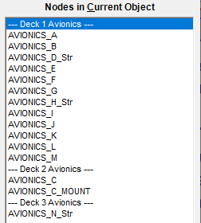
TARP® – Ex. 2, Plot, StripChart, Table, Graphical Table
While the conditional formatting can be applied manually to each
column, it is generally more efficient to use the Copy Formatting and Paste Formatting buttons. Select the HB90 Min column and click Copy Formatting. Then select the HB60 Min column and click the Paste Formatting button. Repeat for all the other Min columns. Then repeat by starting with the HB90 Max column and pasting to all the other Max columns.
The Apply to All Tables button allows for the column definitions, including the limit checking/conditional formatting to be propagated to all other tables. This is useful when a user wishes to keep all the table entries related to a given subsystem, element, or instrument
Close the Properties form and return to the Main TARP Interface. Select Table 1 in the TARP Objects Tree and then select AVIONICS_A in the Nodes in Current Object listbox. Right click to bring up the context menu and select Insert Table Subheading. Enter “Deck 1 Avionics”. Do this again for “Deck 2 Avionics” and “Deck 3 Avionics”.
The order of tabulated entries can be re-arranged by using the Up and Down cursor keys in combination with the Alt key. This even works with multiple items selected, so entire blocks can be shifted. Re-arrange the order as shown to the right. NOTE: this can be done for any TARP objects that have Node/Group/Parameter inputs

Slide 33
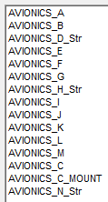
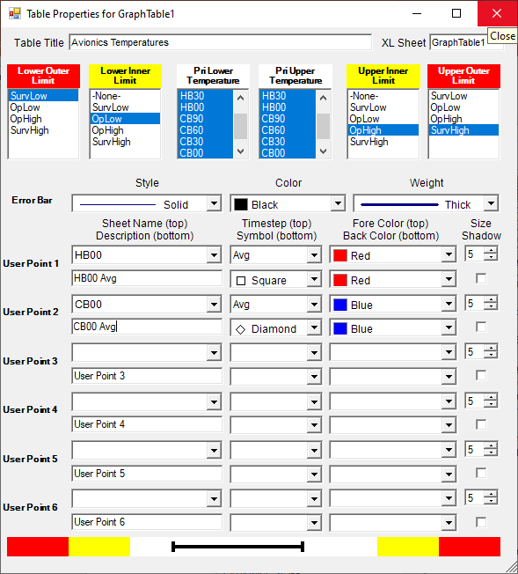
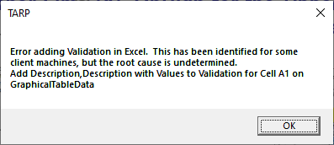
TARP® – Ex. 2, Plot, StripChart, Table, Graphical Table
Select the Avionics groups as shown below and add them to a
new GraphicalTable. Ensure they are in the order as shown below by adding the first block (A-M excluding C) followed by the second block (C,N) or use the Alt-Up/ Down to reorder as shown in the previous example.
Double click the new GrpahicalTable object in the TARP Objects tree to access the properties. Select SurvLow for the Lower Outer Limit (R), OpLow for the Lower Inner Limit (Y), OpHigh for the Upper Inner Limit (Y) and SurvHigh for the Upper Outer Limit. Also, set the Table Title to “Avionics Temperatures”
For both the Lower and Upper Temperature, select all the temperature DataSets (excluding HB90_Q)
Set User Point 1 to use the HB00 Sheet Name, Avg Timestep, Red Fore Color, “HB00 Avg” Description, Square Symbol, and Red Back Color.
Set User Point 2 to use the CB00 Sheet Name, Avg Timestep, Blue Fore Color, “CB00 Avg” Description, Diamond Symbol, and Blue Back Color.
By this point, a Plot, a StripChart, a Table, and a GraphicalTable should all have been properly defined in the TARP interface. Click MakeXL to generate the workbook. The following slides will identify some of the Excel object created in response to these TARP objects…
Ignore This…

Slide 34
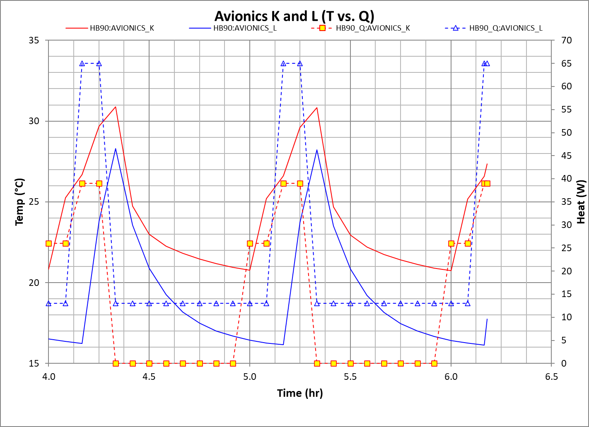
TARP® – Ex. 2, Plot, StripChart, Table, Graphical Table
Plot Output is on its own worksheet named after the Plot object
With the Temperature on the primary Y Axis and the Heat on the Secondary Y-axis, the plot clearly shows the relations between the Power and Temperature.
Linking the Color (Red for AVIONICS_K, Blue for AVIONICS_L) and Linestyle (Solid for T, Dashed for Q) further helps the clarity

Slide 35
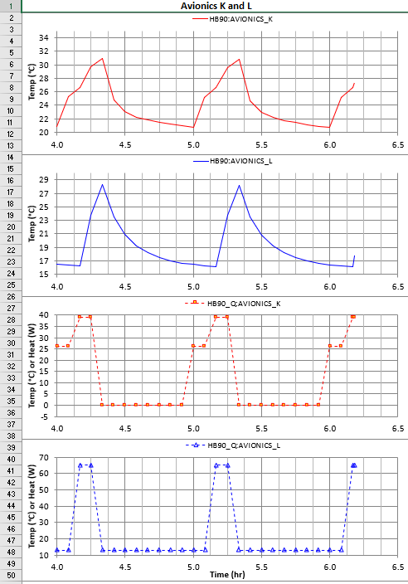
TARP® – Ex. 2, Plot, StripChart, Table, Graphical Table
The StripChart is shown as multiple Excel plots on a single worksheet named after the StripChart object in TARP
Each series (or possibly multiple series) is shown on its own plot with its own series definition (Color, Linestyle, Marker, etc)
This can be helpful when multiple sources can perturb various responses. Note how the AVIONICS_K in Red begins rising before the AVIONICS_L in Blue. From the Power profiles below, the cause can be clearly identified, with the Red Dashed line shown two plateaus for power levels, while the Blue Dashed shows only one
The StripCharts are most useful when multiple areas respond to a disturbance, but with differing degrees of magnitude, which can be challenging to represent with a single Temperature axis.

Slide 36
TARP® – Ex. 2, Plot, StripChart, Table, Graphical Table
Tables are a common way to display large amounts of data to
Stakeholders, with each column representing some set of conditions (e.g. Orbit/Case, Min/Avg/Max, etc)
While they may be effective at displaying the data, an analyst is well served to highlight the particular table entries of importance. Color indicators of text or background is an effective method to draw attention to the important details
Further organizing the table by grouping related Rows and Columns may also help to identify regions or configurations/cases that may be driving the design or identify systemic problems that occurs over nearly all case/configurations.

Slide 37
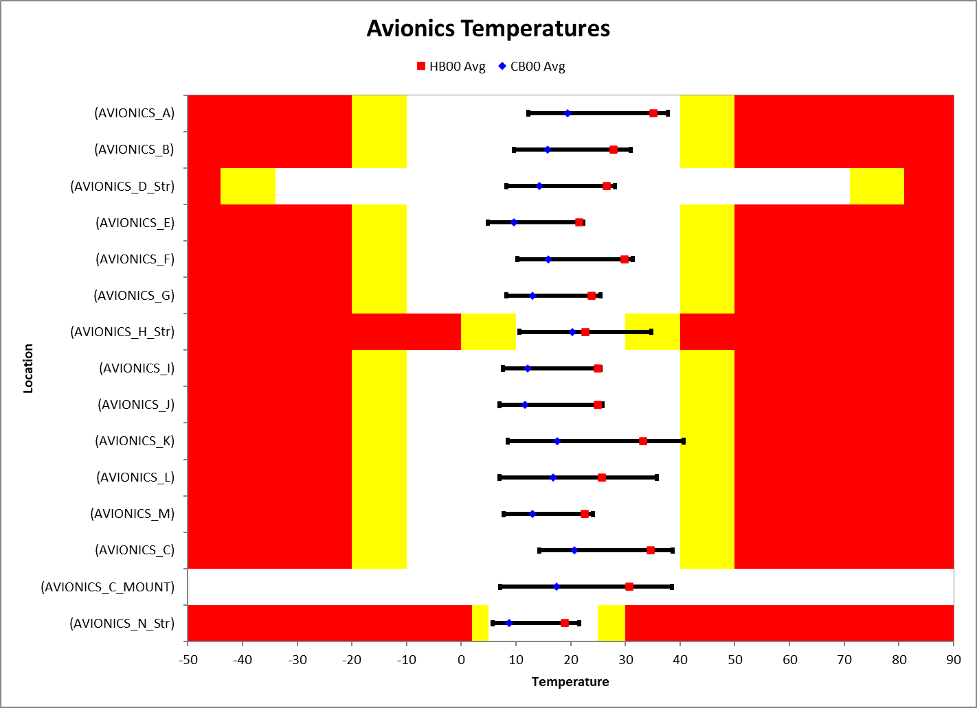
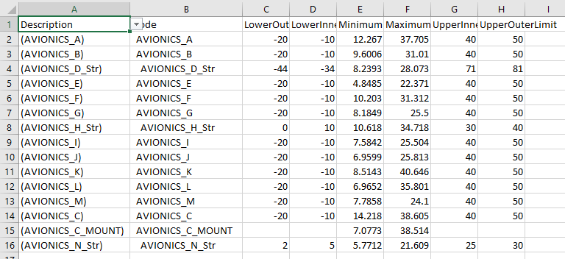
TARP® – Ex. 2, Plot, StripChart, Table, Graphical Table
GraphicalTables are an effective means to convey the overall system performance without the need for displaying a lot of data that may not be relevant
These tables display the range of temperatures for each component within the limits specified and allow for quick identification of where insufficient margin to design limits may exist
The ability to include user points expands the values that may be conveyed and could include differences between Hot and Cold cases, Testing Levels, or any other related data a user wishes to include
It should be noted that all the data is on the GraphicalTableData worksheet, which uses formulas to lookup the data from other DataSets. Lastly, cell A1 can be used to display either the Desc. only or Desc. with Values
NOTE: Excel may prompt to run a macro. If so, this attempts to reconcile the issue with programmatically assigning Validation to cell A1

Slide 38
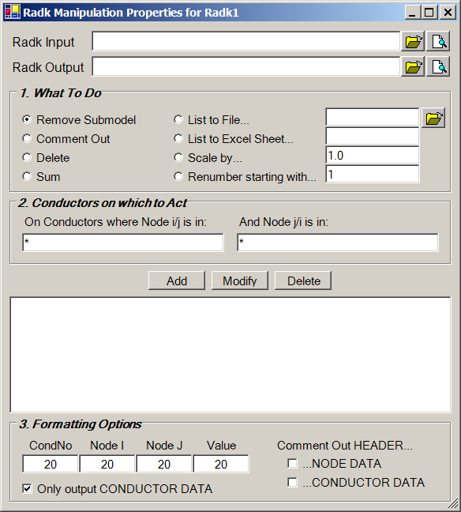
TARP® – RadkManipulations
RadkManipulations allow the user to evaluate and post-
process Radiation Coupling (Radk) output from TSS or ThermalDesktop
Query-like approach
  Specify Input/Output File
  Do some action
  On some set of conductors
  And Output with specified format
Actions
  Remove Submodel
  Comment Out or Delete
  Sum
  List to File or Excel Worksheet
  Scale
  Renumber
Specify conductors
  All Conductors
  Connected to Node(s) I
  Between Node(s) I and Node(s) J

Slide 39
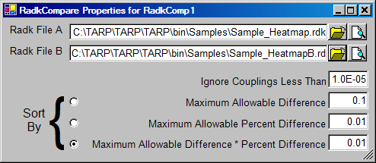
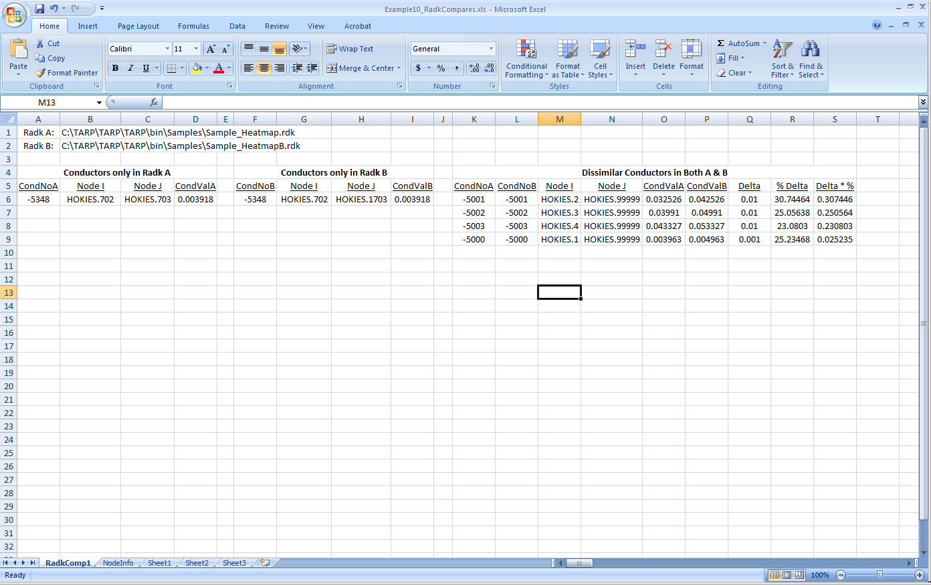
TARP® – RadkCompares
RadkManipulations allow the user to compare Radk output from two TSS or ThermalDesktop files
TARP Input
File Selection
Radks to Consider
  Ignore Negligible Couplings
  Compute and Sort by
    (RK_{a} – RK_{b})
    (RK_{a} – RK_{b}) / RK_{a}
    (RK_{a} – RK_{b}) * (RK_{a} – RK_{b}) / RK_{a}
Output

Slide 40
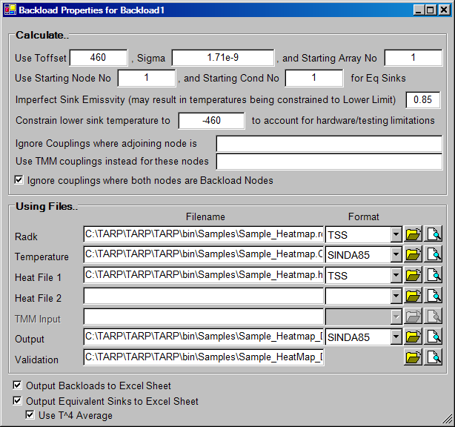
TARP® – Backloads/EqSinks
Backloads and Equivalent Sinks are methods for providing simplistic representations of complex radiative interfaces for a subset of nodes/surfaces
Backloads/EqSinks require (at a minimum) radiation couplings and temperature predictions from an integrated model
Calculate…
  Sigma and Toffset
  Numbering
  Grey Body Sink Estimation
  Lower Temperature Constraint
  Nodes to include/exclude
Using Files
  Radiation Couplings
  Temperatures
  Heat Rates (Environments)
  Output
Validation file displays all radiation couplings and their contribution to the calculations
Output to Excel (as Dataset)
  May use T⁴ average (radiation)

Slide 41
TARP® – Backloads/EqSinks - Calculations
Q_{BL} = Σ (σ * Radk_{ij} * T_{j}⁴)
For all Node_{i} that are in the range of nodes specified for computation and all Node_{j} that are outside that range (if self view is excluded)
Backloads are analogous to how most codes handle Planet IR fluxes and represent an incident heat flux from a thermal scene
The heat rejection (nominally to a space node) is the complement that accounts for the energy balance
Sink Temperatures extend this simplification to produce an effective blackbody temperature to emulate the radiative exchange
T_{Sink} = { [ Q_{ENV} + Σ (σ * Radk_{ij} * T_{j}⁴) ] / [ Σ (σ * Radk_{ij}) ] }^{1/4}
Note that the Sink Temperature has no dependence on T_{i}. This holds true for a perfect blackbody sink. In the case of a test panel with an ε < 1, an approximation may be used which does introduce dependence on ε and T_{i}.
T_{Panel} ≈ { [ T_{Sink}⁴ + (ε_{Panel} - 1) * T_{i}⁴ ] / ε_{Panel} }^{1/4}
Note that mathematically it may not be possible to provide a panel temperature that can emulate the environment. If (1- ε_{Panel})*T_{i}⁴ > T_{Sink}⁴, then no temperature exists that meets requirements
Lower testing temperature limits may also be a constraint (e.g. 80 K for LN2)

Slide 42
TARP® – Examples
Example 1: DataSets, Groups, Parameters, TD
Example 2: Table, Graphical Table, Plot, StripChart
Example 3: Radk Manipulation, Radk Compare, BL/Sinks
Example 4: HeatMaps
Example 5: Advanced DataSets

Slide 43
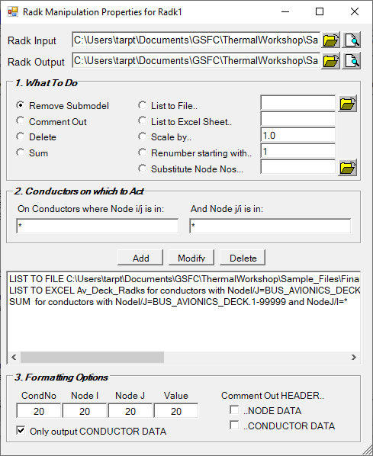
TARP® – Ex. 3:
RadkManipulations, RadkCompares,
Backloads and Equivalent Sinks
Start a new session. Rename Data1 to HB00 and specify the
Hot_b90.out file. Create a second DataSet, name it HB00_Env, specify the Format as Desktop-Q, and select Sample_Hot_b00.hra
Import the groups from Example 1 and create Parameters from the Groups
Create a new RadkManipulation, by right clicking in the TARP Objects tree and select Add RadkManipulation. Double click it to access the properties
Select the Sample.k file for Radk Input file and specify Sample_Adj.k for the Radk Output file
Select the List to File radio button, then use the folder button to specify the file name as Radks_From_Avionics_Deck.txt. In the textbox labeled On Conductors where Node i/j is in:, Enter “BUS_AVIONICS_DECK_Str”. Leave the other text box as “*”. Click the Add button.
Next, select the List to Excel Sheet radio button and specify “Av_Deck_Radks”. Select the Node i/j range as “BUS_AVIONICS_DECK.1-99999” and click Add. Either node ranges or TARP groups may be specified for Node i/j and j/i.
Lastly, add a SUM for BUS_AVIONICS_DECK.1-99999 to “*”. This action will be performed and the result appended as a comment at the end of the Radk Output file.

Slide 44
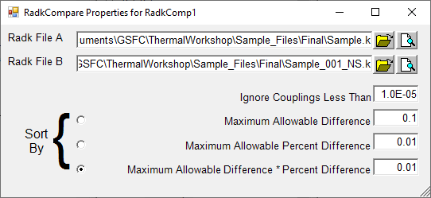
TARP® – Ex. 3:
RadkManipulations, RadkCompares,
Backloads and Equivalent Sinks
Add a new RadkCompare by right clicking in the TARP Objects
tree and select New RadkCompare. Double click to access the properties
Select Sample.k for Radk File A and Sample_001_NS.k for Radk File B. The first file includes radks with a Bij >= 0.001 and those below that cutoff that Sum to 0.95. The second file also includes radks with a Bij >= 0.001, but do not include any below that to meet a sum threshold. These two radk files were generated from the same model but with different runs such that the random nature of the Monte Carlo Ray Trace may be seen.
Leave the remaining defaults as is. Note that these values are unit dependent and these Radk units are in inches squared. Therefore, most all of the radk will be considered; the default values are based on a meters squared assumption.
The Radks that are could in both files but differ by more than allowed are sorted. The preferred key is the (Delta) * (%Delta) such that the larger radks with the larger percent differences are near the top.
A large percent difference on a small magnitude radk or a small percent difference on a large magnitude radk are often less consequential than a large precent difference on a large magnitude radk and could highlight areas of the model where inaccuracies may lie.

Slide 45
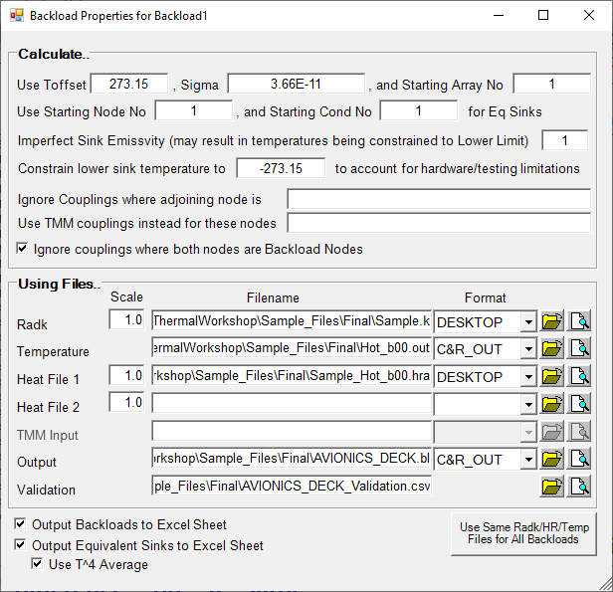
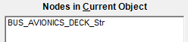
TARP® – Ex. 3:
RadkManipulations, RadkCompares,
Backloads and Equivalent Sinks
Add a new Backload by right clicking in the TARP Objects
Tree and select New Backload. Double click to access the properties
Specify the formats for each file as shown below. Select Sample.k for Radk, Hot_b00.out for Temperature, and Sample_Hot_b00.hra for Heat File 1. Specify “AVIONICS_DECK.bl” for Output and “AVIONICS_DECK_Validation.csv” for Validation. Also specify Sigma as 3.66E-11 (W/in²K⁴).
Check the boxes for Output Backloads/ Equivalent Sinks to Excel Sheet. This will further process the output .bl and .snk files to import the data into the Excel workbook.
Close the properties form and select Backload1 in the TARP Objects tree. Select the BUS_AVIONICS_DECK_Str group from the Working Node List and drag it to Backload1. Ensure it shows up in the Nodes In Current Object listbox. Unlike RadkManipulations and RadkCompares, Backloads do require nodes or groups on which to operate…
Save the session and click MakeXL.

Slide 46



TARP® – Ex. 3:
RadkManipulations, RadkCompares,
Backloads and Equivalent Sinks
The RadkManipulation output can be found in the Sample_Adj.k
file for Sum action, in the Radks_From_Avionics_Deck.txt file for the List to File actions, and on the Av_Deck_Radks worksheet for the List to Excel action
Note that regardless of whether a node range or a group was specified, the output is the same
If the Radks are summed in Excel, the value should be the 4676.545 shown at the end of the Sample_Adj.k file

Slide 47

TARP® – Ex. 3:
RadkManipulations, RadkCompares,
Backloads and Equivalent Sinks
The RadkCompare output is on the RadkComp1 worksheet.
The two files being compared are listed at the top.
The output is shown in three blocks: Radks found only in File A, Radks found only in File B, and Radks found in both that differ by more than the allowable threshold
These are sorted according to the preference specified by the user. In general, Delta * %Delta is preferred to identify larger Radks with larger % differences. That said, Delta, %Delta, and Delta * %Delta are all shown so the user may resort in Excel

Slide 48

TARP® – Ex. 3:
RadkManipulations, RadkCompares,
Backloads and Equivalent Sinks
Backload and Sink output can be found in the file specified by the
User, with Backloads in the .bl file and Sinks in the .snk file.
The output text files are in a format that could be utilized directly with models after placing the generated code in the correct HEADER. For backloads, this includes the ARRAY DATA with Environment and Backload arrays for each node as well as the
VARIABLES1 logic to assign the backloads and environments to the nodes. Sink files include further NODE DATA with the sink node definitions, CONDUCTOR DATA with the radks to the sink node, ARRAY DATA and VARIABLES1 logic to assign the temperature to the sink nodes
If output to Excel was requested, then this data can be found on a sheet named after the backload object with a _BL suffice for Backloads and a _Snk suffix for Eq. Sinks

Slide 49


TARP® – Ex. 3:
RadkManipulations, RadkCompares,
Backloads and Equivalent Sinks
Backload and Sink data output to Excel can also take advantage
of TARP’s group calculations for further represent the data in a manner other than at a nodal level. Backloads for a group are simply the sum of off the nodal constituent values. However, Equivalent Sinks for a group are more complex.
In this case, the weighting factor is used, which is based on the Radk Sum found in the CONDUCTOR DATA block. Therefore, larger area/higher emissivity nodes are given a higher preference over smaller are/low emissivity nodes. Furthermore, since sinks are inherently radiative, a T⁴ averaging is used instead of a pure T, although a user has the option in TARP to specify use of a straight average.
Note, only Groups are computed for Backloads/Sinks (no Parameters, as these are judged to have relatively little usage…)
Equivalent Sinks
Backloads

Slide 50

TARP® – HeatMaps
HeatMaps are one of the most powerful features of TARP, allowing a user to investigate heat flows between nodes and/or Groups. The user has up to 5 levels of grouping available (Major, Minor, Sub, Sub2, and Sub3).
The user must output all Temperature, Conductor, and Heat data to use the HeatMap options. This data (along with the node pairings for a conductor) are read into a specialized workbook containing macros to calculate the heatflow for any timesteps specified in the output workbook. Heatflows may be shown between nodes, groups, or between nodes and groups.
Clicking the Heatmap or Compare HeatMap options under the Workbook Properties branch of the TARP Objects tree will create Binary HeatMap File objects. These should then be populated with the required file names for HeatMap generation
NOTE: Older versions of TARP allowed for DataSets to be created for the storage of HeatMap data, but is now discontinued in newer versions of TARP due to much better performance with the BHF formats.

Slide 51

TARP® – Binary HeatMap Files
Binary HeatMap Files (BHF) are an alternative to storing HeatMap data on Excel Worksheets, which was an option in older versions of TARP but is now considered obsolete
Data from the BHF is read into the HeatMap workbook resulting in much faster generation of HeatMaps, particularly for larger models
  Link between Excel file and BHF is based on filename, so multiple BHF files may be used simply by changing the name of the Excel file
Files/Formats
Filter by Timesteps
Filter by Connections
  Only outputs conductors connected to specified Node/Group
  Trace connections out, up to 5 levels, but terminating at specified boundaries
Filter by Value
  Reserved for future

Slide 52

TARP® – HeatMaps
Once the workbook is generated, the Stefan- Boltzman constant, the offset to absolute temperature, and the time step of interest are specified. At this point, the heat flow through all conductors is calculated and stored internally
Once a node or Group is specified, all connected nodes/ groups are output to the Map1 worksheet. The “Min Heat” may be specified to only output relevant heat flows.
A summary of the node/group is also provided showing the amount of heat transferred by mode and applied.
The format may be changed to display more digits
Output
Replace

Slide 53




TARP® – Output HeatMap Workbook
TARP menu items are included in appropriate workbooks to:
  Create a Matrix of Group to Group HeatFlows
    Data is output at current timesteps from Map1 sheet
    Sheets are created for Major Groups, Minor Groups, SubGroups, and Dynamic Groups
    User may examine Total Heat, Linear Heat, Radiative Heat, Linear Conductance, or Radiative Conductance
Re-initialize workbook
Output Transient HeatFlows for Specified Nodes/ Groups

Slide 54

TARP® – Static HeatMaps
Static HeatMaps display heat flow information for the
requested node or groups on static worksheets (i.e. constant data)
Worksheets are created for each Node or Group selected and displays the Heatflow to connected nodes/groups, the conductance, and the , g the name of the Excel file
Files/Formats
Timesteps to Output
Nodes/Groups to output
  One worksheet created for each selected node/group
Filter by Value
  Specify Sigma and Toffset for Calculations
  Filtering reserved for future

Slide 55
TARP® – Static HeatMaps
Heat Summary
Heat Flows to adjoining Node/Group grouped by Linear or Radiative
Temperatures of Adjoining Node/ Group
Conductances to Adjoining Node/ Group
Each column represents data at indicated timestep

Slide 56
TARP® – Examples
Example 1: DataSets, Groups, Parameters, TD
Example 2: Table, Graphical Table, Plot, StripChart
Example 3: Radk Manipulation, Radk Compare, BL/Sinks
Example 4: HeatMaps
Example 5: Advanced DataSets

Slide 57

TARP® – Ex. 4:
HeatMaps, Binary HeatMap Files, Static Heatmaps
Begin a new session. Expand the WorkBook Properties grouping in TARP Objects and select HeatMap. Notice that the option is now indicated with an (x) to show that the HeatMap option is selected. This tells TARP to use a specialized workbook containing the macros needed to compute heatflow. HeatMaps also expect particular output which must include Temperatures, Heat Loads, and Conductors at each output interval. It does not need QMAP/QDUMP output.
Select the Data1 DataSet and specify the Filename as Hot_b00_HM.out. Also, load groups from the Example 1 TARP session file
Notice that ModelA has been created under the BinaryHeatMaps branch of the TARP Objects tree. Double click this to access the properties and enter the inp and out files.
Options exist to allow the user to limit the timesteps to be processed as well as to only output a portion of the network.
The Trace Levels can be used to expand N levels out from the specified Group/Nodes for a Sub-Network. Termination Boundaries are also suggested to prevent propagation back inwards from a boundary node, such as SPACE…
NOTE: Use of a sub network may make back end processing faster, but does require extra processing up front and limits the usefulness to what was requested (e.g. it cannot show further heatpaths that were not output)

Slide 58

TARP® – Ex. 4:
HeatMaps, Binary HeatMap Files, Static Heatmaps
Add a StaticHeatMap by right clicking in the TARP Objects tree and select New StaticHeatMap. Rename is to HB00_HM. Double click to access the properties.
Select Hot_b00_HM.inp for Input Filename and Hot_b00_HM.out for Output Filename. Also set the Stefan Boltzman Constant to 3.66E-11. This is critical to do for Static Heatmaps since it is used in the calculations. It is also necessary to set the Absolute Temp Offset. It is not critical to do this for Binary HeatMap files since it gets set in the output workbook.
StaticHeatMaps do require inputs for the Nodes/Groups to Output. For each entry, a worksheet will be created with the Heatflows, Adjoining Temps and Conductances.
Add BUS_AVIONICS_DECK_Str to the right most list box by selecting it on the left and using the > button to add

Slide 59



TARP® – Ex. 4:
HeatMaps, Binary HeatMap Files, Static Heatmaps
When Excel opens, it should default to the Map1 worksheet. The Sigma, Toofset, etc are set to their default values. Change Sigma to 3.66e-11, Heat to to SubGroup, and then select the (2) SS entry in Cell C3 for Time. Then click in any other cell to cast the update. Note that the Status bar in the bottom left indicates the progress of the calculations. Wait until it indicates “Ready” (Be sure macros are enabled…)
In cell C2, type in “BUS_AVIONICS_DECK_Str” and then click another cell to cast the update and display the heatmap.

Slide 60

TARP® – Ex. 4:
HeatMaps, Binary HeatMap Files, Static Heatmaps
Note the Summary in the upper right corner which displays the energy balance separating Sources, Linear and Radiative Heat in and out
The left block of data is identical to the right block with the exception of the sort order. All linear heat flows are kept together followed by the radiative heat flows, but the left block shows the largest negative heat to the largest positive, with the right block shows the largest positive to the largest negative
Double-click BUS_PANELS_STR and it now becomes the new Node I and the heatmap is updated accordingly.
The decimal places to display as well as the sort order can also be adjusted by the user if desired.

Slide 61

TARP® – Ex. 4:
HeatMaps, Binary HeatMap Files, Static Heatmaps
Under the Add-ins menu, TARP, select Make Heat Flow Matrix
Group to Group heat flows are created at all five levels of group definition. Select the Minor worksheet. A matrix of heat flows is displayed with each row representing a Group i and each column a Group j. In Cell A1, the value can be updated to show Total Heat, Linear Heat, Radiative Heat, Linear Conductance, or Radiative Conductance. The linear conductance opyion can be a useful connectivity check to ensure that groups which should be connected conductively are indeed connected
The temperatures for Group i and Group j are also displayed. It should be noted that all the data is based on which timestep was selected at the time of worksheet creation. If a new timestep’s data is needed, the Make Heat Flow Matrix should be run again to update the worksheets.

Slide 62


TARP® – Ex. 4:
HeatMaps, Binary HeatMap Files, Static Heatmaps
Under the Add-ins menu, another option exists to create transient heat flows. Select this option to bring up a list of all groups that can be selected. Adding a group/node to the Output Nodes/Group will create worksheets with the same name with all the transient data. Note that this can take some time to process as it needs to compute heat flows at each timestep and store the data before outputting. Add the BUS_AVIONICS_DECK_Str group and click Make Transients
Similar to the Matrix, the What to Show can be changed to show Heat, Adjoining Temperature, or Conductance.

Slide 63

TARP® – Ex. 4:
HeatMaps, Binary HeatMap Files, Static Heatmaps
StaticHeatMap output includes a summary at the top, followed by a block with HeatFlows, then a block of Adjoining Temperatures, and then a block of Conductances, with each column representing a timestep. An average column is also included at the end for all timesteps that are not Stead State.
Feel free to compare the values to the Transient HeatFlows generated from the Binary HeatMap. The main difference is that the StaticHeatMap data is constant and cannot be updated once the workbook is created without going back through TARP.

Slide 64

TARP® Pro – DerivedDataSets
Derived Datasets perform basic computations over all
timesteps to display or normalize data for better evaluation
Select Files, Format, Data, and Sheet Name
  Delta DataSets (A-B)
  Delta T to Initial (T – T_{O})
  Normalized Delta T (T-T_{AVG})
  Temp Rate (dT/dt)
  Delta T over Time (dT/dt*Time)
Convert Units
  Time, Temperature, Heat, Area, Conductance, Capacitance
Control Node Output
  All Nodes, Range of Nodes, Referenced Nodes
Control Timestep Output
Define Last Cycle
  Min, Avg, Max, etc
  Definition of Last Orbit
TARP Input

Slide 65


TARP® Pro – DerivedDataSets
Temperatures (°F) vs Time (hr)
DataSet Output
Temperature Rates (°F/hr) vs Time (hr)
dT/dt DataSet Output

Slide 66

TARP® – MinMaxDataSets
MinMax DataSets allow for many files to be processed to determine the minimum and maximum temperatures without the need for individual DataSets
Select File(s), Format, and Data Sheet Name
Convert Units
  Time, Temperature, Heat, Area, Conductance, Capacitance
Control Node Output
  All Nodes, Range of Nodes, Referenced Nodes, Transpose
Control Timestep Output
Define Last Cycle
  Min, Avg, Max, etc
  Definition of Last Cycle
Two outputs: (MinSheetName, MaxSheetname)
  Min has minimum temp. for each File
  Max has maximum temp. for each file
TARP Input

Slide 67


TARP® – MinMaxDataSets
MaxMinMax1
Output
MinMinMax1

Slide 68

TARP® Pro – UserDataSets
UserDatasets perform complex computations to allow users to output a variety of data types in the same DataSet
TARP Input
Select Files, SheetName
Specify DataRow
  Node, Submodel, or Group
  Data Type [Bulk]: T, Tmin, Tmax, Q, Env, Sink, BL, C
  Data Type [Connection]: Heat Flow (Total, Linear, Radiative, Radk), Conductance (Linear, Radiative, Radk)
  Nodes, Submodels, or Groups to use in calculations
DataRows to Compute
Control Timestep Output
Define Last Cycle
  Min, Avg, Max, etc
  Definition of Last Orbit

Slide 69

TARP® Pro – UserDataSets
TARP Input
TARP Output

Slide 70
TARP® – Examples
Example 1: DataSets, Groups, Parameters, TD
Example 2: Table, Graphical Table, Plot, StripChart
Example 3: Radk Manipulation, Radk Compare, BL/Sinks
Example 4: HeatMaps
Example 5: Advanced DataSets

Slide 71

TARP® – Derived, MinMax, and User DataSets
Either begin a new session or start from Example 1. The DataSets
Groups and Parameters all need to be created for this example. The previous session can be loaded using the Load Session button on the main Toolbar
Add a DerivedDataSet by right clicking in the TARP Objects tree and selecting Add DerivedDataSet. Name it HB90_Stablity and double click to access properties. Select the Derived Type of T(t) – T(Avg) and the Hot_b90.out file. This will output a normalized temperature with the nodal averaged removed. This can be a useful way to visualize stability with all values referenced to the average temperature.
Convert the time from sec to hr, and select from 4 to the end for the Last Cycle Definition
Other derived types include A-B, T(t) – T(0), dT/dt, and dT/dt*TimeIncr
Close the properties for to return to the Main Interface. Select the HB90_Stability Derived DataSet, and then select AVIONICS_K and _L from the Working Node List and add them to a new plot.
The select the HB90 DataSet, again select the two avionics groups and add them to the same plot. Note that when a DataSet of any type is selected, the Working Node List is updated with the available nodes, Groups, and Parameters

Slide 72

TARP® – Derived, MinMax, and User DataSets
Edit the two series on the plot referencing the DerivedDataSet
and set them to use the Secondary axis. At this time to only way to add series data to a plot that references a DerivedDataSet is to utilize the implied last selected DataSet (i.e. the source can only be changed to a DataSet and not a DerivedDataSet)
Set the Plot properties as shown below:
Series | Source | Data | Axis | Style | Color | Marker | Fore Color | BackColor
1 | HB90 | AVIONICS_K | Pri | Solid | Red | None | N/A | N/A
2 | HB90 | AVIONICS_L | Pri | Solid | Blue | None | N/A | N/A
3 | HB90_Stability | AVIONICS_K | Sec | Dotted | Red | Square | Red | Red
4 | HB90_Stability | AVIONICS_L | Sec | Dotted | Blue | Diamond | Blue | Blue
Add a MinMaxDataSet by right clicking in the TARP Objects tree and selecting Add MinMaxDataSet. Name it AllCases and double click to access properties.
Select any file using the folder button that is in the same directory as the Hot_b90.out and the Available Files listbox will be populated with all other files that meet the Pattern in that same directory
Select HB and CB 00, 30, 60, and 90 and click Add Selected Files to include them in the Files to Process listbox. Indivdual files may also be included using the Add User File button if desired. Files can be deleted by selecting them in Files to Process and pressing Del.
Convert Time from s to hr and select 4 to the end for the Last Cycle Definition

Slide 73


TARP® – Derived, MinMax, and User DataSets
Create a Table with all the DataSets and columns for Min, Avg, and Max. Note that both the DerivedDataSet and the MinMaxDataSet are also listed as available DataSets to assign to a column. Select the AllCases and note that it allows for Min, Max, MinCase, and MaxCase for the column parameters
Add a Min Column for AllCases, followed by a MinCase, then a Max, and lastly a MaxCase.
Apply the same conditional formatting described in Example 2 to each Min and Max column. Return to the main menu and ensure the TARP Object tree looks like:

Slide 74

TARP® – Derived, MinMax, and User DataSets
User DataSets are the most complex objects in TARP but allow for a wide range of output options
Begin by selecting the Output File, Input File, and Env Heat File as shown to the right
Next, specify the Sigma and Toffset
Each row of UserDataSet output needs to be defined and follows the pattern LEVEL:DATA(SOURCE) where LEVEL is NOD, SUB, or GRP. DATA varies and all the options are shown in the form to the right. SOURCE is the node, group, or submodel to be used in the computation
Select GRP in the 1. Level frame, then select TEMP in the 2. Data frame. Lastly, select the BUS_AVIONICS_ DECK_Str group in the 3. Node/Group Selection. Click the + button to the right of the Node/Group I textbox. Then click the Add to List button to the left to add that data row definition. Add the HEAT and ENV data rows next

Slide 75
TARP® – Derived, MinMax, and User DataSets
Some options under the 2. Data frame require two input, such as HeatFlows or Conductances. This requires a user to also specify a value in the Node/Group J textbox. This can be done using the second + button beside the Node/Group J textbox
Alternatively, a user may also simply type the required text User Input and click the corresponding Add To List button
Add the HF Data Row, as well as the SINK, BL, GR, and GK DataRows
This will output a wide variety of data points including the Temperature, Heat, Environmental Heat, Backload, and Sink Temperature for the BUS_AVIONICS_DECK_Str group and the HeatFlow and Conducatance between BUS_AVIONICS_DECK_Str and SPACE.
Close the properties form, return to the main interface and click Make XL.

Slide 76

TARP® – Derived, MinMax, and User DataSets
Note on the HB00_Stability worksheet how all nodes have an
average of nearly zero. This is expected since all values have the average subtracted, therefore half the data is above the average and half is below, making the average of the computed values near zero
Visualize the plot. Make note of the differing time scales and Pirmary Y ais and Secondary Y axis ranges.

Slide 77


TARP® – Derived, MinMax, and User DataSets
Note that the AllCases MinMaxDataSet produced two worksheets:
MinAllCases and MaxAllCases.
Note in the Table that the Min and Max values from the MinMaxDataSet columns do indeed represent the coldest and hottest temperatures across all cases as well as indicating in which case the global Min and Max can be found

Slide 78

TARP® – Derived, MinMax, and User DataSets
The UserDataSet format is similar to other DataSets, except that it has no definitions of Groups/Parameters since each DataRow is unique and does not lend itself to any further grouping or reduction
One thing to note is that the values computed for the BL and Sink are different from those computed in Example 3. The reason for this is that UserDataSets do include self view in the computations. If Example 3 is revised to include self view (i.e. uncheck the “Ignore couplings where both nodes are Backload Nodes”, then the same values would be produced.
Also note that the GR summation is zero, since couplings to space would be found in the Radk File and therefore are summed in the GK computation. However, if no Radk file was specified, then these values would be found in the Input File and GR would be non-zero.
Lastly, note that the sign for heatflows is negative if leaving Group A and going to Group B and positive if leaving Group B and entering Group A

Slide 79


Slide 80
COVeR® – Introduction
Commercial Thermal solvers provide temperature output for models based on heat and conductor inputs
The post-processing of results is generally left to the user.
COVeR brings this data into an independent environment to allow further post processing including:
  Import of direct output including Temperatures, Heat Loads, Capacitances, Environmental Heat Loads
  Calculation of indirect output including Heat Flows, Backloads, Equivalent Sinks, and Radiation Exchange Factors
The COVeR environment allows for grouping of nodes into logical component blocks, plotting of nodal or group data, and block diagram layouts for heat flows

Slide 81

COVeR® – Data Selection
To begin, a Cover data file must be either created or loaded. This form allows the user to define what data to include or calculate or which existing file to load. It also allows the specification of what Group file to apply.
Data loaded from Output File, Input File, EnvHeat File, and Radk File
Radks and Env Heats can be used to calculate Backloads and Equivalent Sinks Objects
New file may be created to store data or existing file may be specified to load
Group File may be varied to recombine nodal data as needed by new group definitions
Output data may be filtered by Timestep or Connection to reduce data size

Slide 82

COVeR® – Main Interface
Once a Cover data file is loaded, the data is available for further use. Once a Node, Submodel, or Group is selected, the associated data is displayed in the Plot, Graphics, and Heat Flow areas.
Once all Group Heat flow calculations are completed, the heat flows may be shown in block diagram form in the Graphics Area
Navigation Pane where nodes, submodels, or groups of interest are selected
Graphics Window where Plots or Graphical Heat Maps are displayed
Plot Data Window where values associated with Selected entity are shown
Heat Flow Data Window where connected entity heat flows are displayed
Status bar where indicators show the available data or what is still processing

Slide 83
COVeR® – Example 1, Data Selection
Start COVeR
Select the FileOpen button by Output File and select Hot_b00_HM.out. This will load and store all the nodal temperatures, heats, and capacitances as well as the conductor values for each timestep in the resulting .cvr file. The Checkboxes can be used to specify what data should be extracted
Click the HeatFlows checkbox to enable the Input File text box and select the Hot_b00_HM.inp for the Input File. This will load and store the nodal connections made by each conductor in the resulting .cvr file.
Click the Env Heats checkbox to enable the Env Heat File text box and select the Sample_Hot_b00.hra file. This will load and store the nodal heat rates generated by various Radiation Thermal codes. While the timesteps are likely not synchronized with the output file, the data is used to interpolate for the output file timesteps.
Click the Radks checkbox and to Enable the Radk File text box and select Sample_0001_NS.k. This will load and store the Radks in the resulting .cvr file. If an Input File is also specified, the network connections are tagged to indicate which radiation connections are also radks, to identify external vs. internal or MLI conds.
Click the Backloads and Eq Sinks check boxes and specify the correct Sigma and Toffset. For these files, Sigma should be 3.66E-11 and Toffset should be 273.15. This will calculate and store the nodal IR backloads and Equivalent Sink temperatures based on Temperatures from the Output File, heat loads from the Env Heat File, and radiation couplings from the Radk File.
Check the Top Level Prefix box
Click Create to generate the .cvr file. The filename will be automatically specified.

Slide 84


COVeR® – Example 1, Data Selection – cont’d
Note that both Nodes and Groups are populated in the Navigation Tree, even though no Group File was specified.
If no Group File is specified, the Submodels are used to define groups, with options to separate MLI based on the MLI Offset numbering scheme (e.g. Nodes > MLI Offset are considered insulation [SubNam_Ins], whereas nodes < MLI Offset are considered structure [SubName_Str] ).
Furthermore, a TopLevelPrefix option exists to further group submodels based on like prefixes using “_” as a delimiter.
By default, nodal level data is not included in the Navigation Tree, but can be added by the user if desired for specified Submodels or Groups. Select the Submodel or Group and right click to bring up the context menu and then select Add Nodes to Tree for Group/ Submodel.
When an entity is selected in the Navigation Tree, the Plot Data Grid, Graphics Window, and Heat Flow Data Grid are populated

Slide 85
COVeR® – Example 1, Data Selection – cont’d
The Status Bar at the bottom indicates the computation progress.
Each cell represents a particular computation (e.g. Group Temperatures, Group Heat Flows, etc). If it is flashing, that indicates it is still calculating; once complete, it stops blinking. The heat flows indicate the % completion due to their longer duration.

Slide 86



COVeR® – Plotting Interface
Top rows of Plot Data Grid can be used to toggle series Visibility, Color, LineType, and Axis
Axes Values (with Autoscale)
Plot Builder allowing for Full control over series:
  Node/Group/Submodel
  Source
  Data Type (including Heat Flows)
  Series properties
Window zoom on plots, Shift-Click to go back. Click in grey border to show Properties

Slide 87
COVeR® – Example 2, Plotting
Start a new COVeR session and load the .cvr file from Example 1.
Also, specify the Group File from TARP Example 1. Groups and COVeR data files are not linked, since for a given set of results from a model, the nodal and conductor data does not change; however, a user may opt to redefine Groups to interpret the data. Therefore; the group file is a separate entity from the data file. Heat flows are recomputed each time when a Group File is specified.
Select the BUS_AVIONICS_DECK_Str in the Groups branch of the Navigation Pane to the left. The plot window is now updated to display the Maximum, Average, and Minimum temperature for the selected group.
The data itself is shown in the Plot Data Window on the right and allows for control over what is displayed in the plot. Click and Drag the solid black line between the Plot Data and Graphics windows to the left to resize the Plot Data Window.
Cells in the top header of the Plot Data Window can be clicked to toggle the display behavior. The first row controls the visibility of the series. Change the “No” in the Show row and Heat Column to “Yes” by clicking it. Notice that the Plot Window now displays the Heat with a secondary axis on the right.
Click on the Heat-Color cell 4x. This toggles forward four colors to Turquoise and the plot is updated accordingly. Shift click toggles in the reverse order. The same approach is used for Linetype and Axis toggles.
As the cursor is moved around the plot, the coordinates are displayed in the bottom right panel of the status bar. Clicking and dragging a window on the plot will zoom in. Holding down the Ctrl key while dragging will display the dt and dT values instead of the coordinates. Clicking in the plot again will remove the dt/dT line.

Slide 88

COVeR® – Example 2, Plotting – cont’d
The Plot Window should look similar to this…

Slide 89


COVeR® – Example 2, Plotting – cont’d
Left Click near (1200,27) and drag to (4200,15) to zoom in to this area
Shift-click on the plot to return to the previous view
Click in the Grey border around the plot to display the Plot Properties form
Select X-Axis Minimum of 1200, Maximum of 4200, and Subdivision of 500
Select Y-Axis Minimum of 15, Maximum of 27, and Subdivision of 2 and Click Update
The plot should look like when zoom was applied, except for the subdivisions
Select the Preferences tab and ensure Stefan Boltzman is set to 3.66e-11
Click the plot again to activate the Plot Properties
Make sure in the Series Properties frame that Group is selected
Change Data Type to Heat Flow
Select Node/Group i as BUS_AVIONICS_DECK_Str and Node/Group j as SPACE
Set Color to Orange and Linetype to Ditted
Set Axis to Sec and Label to HF and Click Add
Append “(w HF to Space)” to the Plot Title and Click Update

Slide 90



COVeR® – Heat Flow Interface
Heat Flow grid can show All Timesteps, Selected Timestep, Or Group to Group Matrix of Total, Lin, Rad, or Rdk Heat Flows or Lin, Rad, or Rdk Conductances
Display can include columns for Bij, Temperature, Conductance, and Heat Flow
Minimal Heat Flows can be hidden
Display order can be updated
Average Heat Flows can be computed over specified range of timesteps. Useful when heaters or environments are cyclical
Double-Click on Group i to display heatflows at next lower level
Double-Click on Group j to make it current Group i

Slide 91

COVeR® – Example 3, Heat Flow Interface
Start a new COVeR session and load the .cvr file from Example 1.
Be sure to load the groups form TARP Example 1 before clicking the Load button.
Ensure that Sigma is set to 3.66e-11 on the Preferences Tab. Again select the BUS_AVIONICS_DECK_Str group under the Groups branch of the Navigation Tree.
Examine the Heat Flow Data Grid below the Graphics Window. Click and Drag the solid black line between them to enlarge the Heat Flow Data Grid
Notice that the first non-fixed column displays the Bij value for each group to the OuterSides group. This column is only included if the user specified a Radk File during the .cvr file generation. Otherwise, these couplings would have been read as general Radiation Couplings from the input file. Including the Radk File allows identification of external Radks as different from radiation couplings from the thermal model. The Bij term is calculated based on the sum of all radks between two groups divided by the sum of all radks from the selected group.
The Heat Map control bar above the table allows the user to control the output, including display of Temperatures, Conductances, and Heat Flows and Sort order. Uncheck the Temperatures and Conductances boxes to see only Heat Flows.

Slide 92
COVeR® – Example 3, Heat Flow Interface - cont’d
Clicking on the T or Q columns to the left of each connection will
display the connection Node/Group Temperature or Heat Flow respectively on the Plot in the Plot Window. Columns of the data are also added to the Plot Data Grid, with control over the series display just as any other column. Click the cell in Q column and the SPACE row to add the heat flow to Space to the Plot.
The ordering of the output can also be specified by the user. Nominally, it sorts by Type (Lin, Rad, Rdk) then by Heat Flow Value, but the user can also sort based on Node/Group Name, Conductance or Temperature as the second key. The first key will always be the Type. Select Type then Node from the Sort By dropdown.
Lastly, the Min Heat field can be used to display only relevant connections as defined by the user. Changing the Min Heat filed will filter the output data in the Heat Flow Window to display only connections where the Min Heat value was exceeded at any timestep. Enter 1 in the Min Heat field and notice that fewer rows are now displayed. Note that the row indexes on the left are non-sequential. This indicates connections that were not displayed because they did not meet the Min Heat criteria. Entering a Min Heat of 0.0 will display all connections.
Finally, the Heat Flow Data can be easily copied and pasted into a spreadsheet for further use. Select any cell in the Heat Flow grid and type Crtl-C or Ctrl-Ins. Now, open an instance of Microsoft Excel and select Cell A1. Type Ctrl-V and the data from COVeR is now in Excel. This same behavior also applies to the data in the Plot Data Grid
This same Copy and Paste is also available for the Graphics Window. Click the Graphics Window and type Ctrl-C. Now paste the image onto an Excel worksheet.

Slide 93



COVeR® – Example 3, Heat Flow Interface - cont’d
The data displayed in the Heat Flow Data Grid may also be varied.
Select the Preferences tab and then select Show Selected Timestep from the dropdown. Timesteps are selected in the Plot Data Grid. Select the second SS entry (the first is an initial condition). The select the BUS_AVIONICS_DECK_Str in the Navigation Tree. If nothing changes, select another group and then re-select to refresh
Reset the HeatFlow Table Preferences back to Show Transient. Scroll to the end of the transient timesteps and not the Avg column. Any timesteps (or data) colored in blue indicates its inclusion in the average.
To change this, select the range of timesteps over which to average in the Plot Data Grid and then click the Set Avg button on the Heat Flow Data Grid toolbar. Note that timesteps not included in the average are now colored black to indicate their exclusion.
Selected timestep highlighted
Average HeatFlow Display
Selected timestep HeatFlow Display
Timesteps included in Average shown in Blue

Slide 94


COVeR® – Example 3, Heat Flow Interface – cont’d
The HeatFlowGrid can also display heat flows in a matrix format
For the currently selected timestep
This data quickly becomes too cumbersome to effectively view in COVeR, but a simple copy and paste to a spreadsheet allows this data to be further manipulated by a user
HeatFlow Matrix
HeatFlow Matrix Pasted into Excel

Slide 95

COVeR® – Graphical HeatMaps
Once the Group Heat Flows are calculated, the groups may be added to the canvas. Once added, they can be repositioned into a logical arrangement. Then connections may be dragged to avoid confusion to generate the final layout. This layout may be saved for future retrieval for additional cases.
Each Group is shown as a box on the canvas that can be sized or repositioned.
  Color indicates temperature as shown in the legend
  Temp, Heat, or Imbalance can be shown as text in box
  Boxes can be moved to desired locations and connectors stay attached
Connectors are shown between boxes to indicate heat flows or conductances
  Text indicates Heat Flow (Linear, Radiative or Total) or Conductance (Linear or Rad.)
  Connectors can be dragged into desired place with promotion (I→L, L→S, etc.)
  Linetype and color control
  Minimal connectors may be hidden

Slide 96


COVeR® – Graphical HeatMap Creation Process
9
3
5
4
6
7
8
2
1
Add all Groups to Canvas
6
Control Group Box Display
2
Select Timestep
7
Control Connector Display
1
3
Control Group Box Visibility
8
Set HeatMap Title
Save Layout
4
Ensure all Group Boxes are on Canvas
9
5
Control Connector Visibility, Linetype, Color, Weight

Slide 97




COVeR® – Example 4, Graphical HeatMap
Load the .cvr file from Example 1 but before clicking Load, select
the TARP_Example1 session for the Group File to load these Group defintions
Once the Status Bar indicates the Group HeatFlows are complete, right click in the Navigation Pane and select Show Major Groups on Canvas. The Window will look like this:
Select the AVIONICS_ group and then select the second SS timestep in the Plot Data Grid. This is how the current timestep can be changed for the Heat Flow data. The window will now look like:
If the ColorBar button is enabled on the Toolbar, then the Temperatures of each block corresponds to the color in the Legend in the lower left hand corner.
As it is, the display is hard to read. So, the boxes need to be dragged into a better position for improved readability. Click the MISC box and hit delete to remove it from the canvas. Next, click the SPACE box and drag it to a new position on the canvas. Drag each box until the layout looks like below:

Slide 98


COVeR® – Example 4, Graphical HeatMap
At this point, the groups are nicely positioned, but the
connectors overlap, making it unreadable. Fortunately, the connectors can also be dragged and reshaped. Select the connector between PANELS and SPACE by clicking on the vertical line. Drag this to the right until the vertical line reaches the edge of the PANELS box. Notice that it now changes from an S shape to an L.
When a connector is selected, it is indicated with yellow highlighting. This can be used to click on a connector to select it and then to click again on a segment to move it into place. When a connector is selected, subsequent clicks will first determine if a segment of the selected connector was picked. If so, then this will over ride other segments of other connectors that may be coincident.
Connectors may also be manually removed from the display by pressing delete.
Drag the remaining connectors into shape until it looks like this:
The location of the connector value can also be moved along the connector by clicking and dragging it
Save the layout by clicking the Save Layout button and enter COVeR_Example4.clo

Slide 99


COVeR® – GroupBox and Connector Control
GroupBox Control
  Toggle On/Off for GroupBoxes
  All Related Connectors also impacted
Connector Control
  Operates on Connectors specified in query-like manner (e.g. SPACE to *)
  Further filter by direction and magnitudes of Total, Linear, Radiative, or Rdk heat flows
  Hide or Show connectors meeting criteria
  Set Color, Linetype, or Weight for connectors meeting criteria

Slide 100



COVeR® – Summary Box and Residuals
Residuals show any the effect of any missing connections
  Top (Linear heat in:left, out:right), Bottom (Radiative heat in, out right)
Connectors not shown on the Canvas have white background
Connectors shown are highlighted in blue
Summary Box shows Lin, Rad, Rdk, and Applied heat into and out of Group Box
  Residual heat connections also shown (Lin In, Lin Out, Rad+Rdk In, Rad+Rdk Out)
Summary Box shows Lin, Rad, and Rdk heat flow through Connector

Slide 101


COVeR® – Automatic Layouts
Right click to access Context Menu.
  Select Make HeatMap for Selected Group and Canvas Level
Automatic Layout
  Max of 8 Groups
  Highest Heat Flows into or out of selected group displayed
  Thick lines for connection to selected group
  Solid Lines for Conductors
  Dashed Lines for Radiation
  Connections between all other 8 groups also displayed

Slide 102


COVeR® – Miscellaneous
Specify Stefan Bolzman (Multiplier)
Decimal Place to Display
Unit Conversion available
Control what data is displayed in Plot Data Grid
Compound Connectors to Show Lin, Rad, and Rdk values separately (but in multi-line connector)
User customizable ColorBar useful when large temperature differences between groups exist
AutoSave layout frequency
Link Canvas and Tree Selections. When Group is selected in Tree, it is also selected in Canvas and HeatFlowData grid is updated
Ctrl-C to copy Plot or Graphical HeatMap image, Plot Data, or Heat Flow data to clipboard

Slide 103


COVeR® – Example 5, Graphical HeatMap - Intermediate
Load the .cvr file from Example 1 but before clicking Load, select
the TARP_Example1.trp file for the Groups and set Sigma on the Preferences Tab
Select the BUS_AVIONICS_DECK group, right click and select Make HeatMap for Selected Group – Minor Canvas. This will auto-populate the canvas with a predefined layout for the top 10 connections

Slide 104
COVeR® – Example 5, Graphical HeatMap - Intermediate
Click the two Residuals buttons to display the Residuals.
These show any remaining heat that is not displayed via a connector. Arrows on the top of the box show missing linear heat in (left) and out (right), while arrows on the bottom show missing radiative heat in (left) and out (right)
Boxes can also be resized by dragging a corner to grow or shrink the box. However, if the requested size is insufficient to display the text associated with the box then COVeR will automatically reset the box back to its original size.
The Boxes can be tailored to display the Temperature (Heat), Heat, Environment, Temperature, Max Temperature, Min Temperature, Imbalance, or Nothing. Click the buttons and observe the changes. By default, the T (Q) option is selected, which shows both Temperature and Applied Heat.
The Connectors can also be tailored to display the Total, Linear, Radiative, or Radk (External Radiative) Heat flow or the Linear, Radiative, or Radk Conductance, or Nothing using the buttons on the toolbar.
The number of digits for display of Connector and Box values can be changed using the Format DropDown. Currently, 0, 0.0, 0.00, and 0.000 are provided. If a Connector value is zero given the current format, the Connector will not be displayed.
Lastly, the HeatFlows may be animated by clicking the Animate button. This will prompt for a delay of 1, 2, or 3 seconds between Timesteps. The ColorBar is recalculated to account for the temperature range over the entire time space. Pressing ESC will exit the animation process.

Slide 105



COVeR® – Example 6, Graphical HeatMap - Advanced
Often, it is preferred to highlight the important heat paths.
Selecting a connector and right clicking bring up a context menu that allows for individual changes to be made, such as linetype, weight, or color. Select the connector between BUS_AVIONICS_DECK and SPACE, right click, and select Set Color and select Blue.
Often, it is preferred to highlight the important heat paths. Selecting a connector and right clicking bring up a context menu that allows for individual changes to be made, such as linetype, weight, or color. Select the connector between BUS_AVIONICS_DECK and SPACE, right click, and select Set Color and select Blue. Repeat for a Dotted Linetype.
Changing each connector would be quite tedious. It is often better to use the Connector Query. This allows for multiple connectors to be operated on based on a variety or properties: connection (I and J) or Total, Linear, Radiative, or Radk Heat above or below some threshold. Operations include: Show/Hide, Set color, LineType, and Weight. Set all Connectors with a Lin Heat > 0 to Green, Dashed, with a weight of 1.
Select that same connector, right click, and select Plot Total Heat Flow. This will create a separate window with a plot of the heat flow on the secondary axis and temperatures for the two groups on the primary axis.

Slide 106

COVeR® – Example 5, Graphical HeatMap - Intermediate
Select the Avg timestep from the Plot Data Grid. The HeatMap
should look as shown below

Slide 107




COVeR® – Example 6, Graphical HeatMap - Advanced
Ensure the Highlight Visible Connectors in Heat Flow Data Grid
option is checked under the Preferences tab. Also, ensure the Heat Flow Data Table Preferences is set to Show Selected Timestep. Select the BUS_AVIONICS_DECK group in the Navigation Tree and then select the second SS timestep in the Plot Data Grid. Notice that the paths highlighted in blue are the same ones displayed on the Graphical Heat Map. As seen from this listing, AVIONICS_D and AVIONICS_F are both not displayed.
Box display can be controlled from the GroupBox properties form. Holding down Ctrl, select AVIONICS_D and AVIONICS_F to add them to the GroupBoxes that re displayed on the canvas. Ensure Update connector visibility to updated boxes is checked. This will also update the visibility for any connectors where both GroupBoxes are visible. Note that they did not
come in to a good location. Drag them to the
location shown below.
Note how the connectors stay attached to the Group Box as it is moved. If a connector is ever orphaned from its GroupBox, select the connector and right click to bring up the context menu and select Reset to AutoDraw

Slide 108



COVeR® – Example 6, Graphical HeatMap - Advanced
Select the connector between BUS_AVIONICS_DECK and
AVIONICS_F and press the delete key. This will remove it from the canvas (i.e. set its visibility to off). Note that the Heat Flow Data Grid will now show this heat path with a white background, indicating it is not displayed on the canvas. Click the cell in the first column and same row as AVIONICS_F. This will toggle the visibility of a connector and represents another method to turn on or off a connector’s visibility.
Click the middle segment and drag it as shown below. Then click the bottom segment and drag it as shown. Note that S connections may become L connections and vice versa. Connectors can be expanded to a maximum of 4 segments while remaining connected to their GroupBox.
Click the SS Timestep and then the Avg timestep to update the Residual values
Select the BUS_AVIONICS_DECK to AVIONICS_F connector and drag the text as shown. This allows the values to be displayed in a logical location (generally either leaving or entering a Group Box). Also, update AVIONICS_D as shown.

Slide 109




COVeR® – Example 6, Graphical HeatMap - Advanced
Ensure that the Summary is enabled and select the GroupBox for
BUS_AVIONICS_DECK. Take note of the summary box in the upper right hand part of the canvas. This shows a variety of useful metrics, such as Heat Applied, Temperature ranges, Heat In and out by type (Lin, Rad, Rdk), and what is not displayed (e.g. Residuals)
Similarly, Connectors have their own summary including: Temperature of the GroupBoxes, Linear Conductance/Heat and Rad and Rdk Conductance/Heat
Clicking the Title in the top right corner allows the user to specify text of their choosing
Lastly, click the Draw Compound Connectors option on the Preferences tab. This will display up to three color coded lines for each connector separating the Lin, Rad, and Radk components

Slide 110
COVeR® – Graphical HeatMap – On Your Own
Load the .cvr file from Example 1 but before clicking Load, select
Example3_GroupParams.trp for the Groups and set Sigma on the Preferences Tab
Add Sub Groups to the Canvas and arrange the layout as shown on the next page.
Uncheck the Link Canvas and Tree Selection on the Preferences tab. This prevents COVeR form updating the HeatFlowData grid and Plot Data grid every time a new GroupBox is selected on the canvas (can be time consuming for larger models)
Move and Resize the SPACE GroupBox
Right click and set all Radk Only Linetypes to Dashed
Hide all connectors with a Total Heat Flow < 1
Set all connectors with a Linear Heat Flow > 0 to Blue, with a 2 weight
Set all connectors with a Rad Heat Flow > 0 to Green, Dotted, with a 2 weight
Set all connectors to SPACE to Red, Dashed, with a 3 weight
Click the HeatMap Title and set it to SC Sample HeatMap
Save this layout as Example_OnYourOwn.clo.
Close COVeR and re-open a new instance. Load the previously create .cvr file with the TARP_Example1.trp groups
Add all groups to the SubGroup canvas.
Load the previously saved Layout file. Click on a new timestep to update the data.
One last thing to note. Click the Remove Env From Heat to Space on the Preferences tab and note the differences. This option removes the Env heat from the total heat applied to a GroupBox as well as from the connector to SPACE. This option allows for better comparison between flight predicts and a test setup which does not typically have environmental fluxes simulated.

Slide 111

COVeR® – Graphical HeatMap – On Your Own
Flight HeatMap

Slide 112

COVeR® – Graphical HeatMap – On Your Own
Flight HeatMap (with Env Removed) to Compare to Test HeatMap

Slide 113

Contacts and Downloads
TARP® is available for download from the website: http://www.tarpthermal.com
Without a valid license file, TARP opens in Demo Mode, allowing the user to have fully program functionality (with the exception of loading session files) but only with the provided sample files
To obtain a temporary license for trial purposes only, or to request a quote, please contact Hume Peabody at tarpthermal@comcast.net

